Slide 1
SF02B – Comment devenir un Chasseur de Stress – Compétence Gestion du Stress

Slide 2
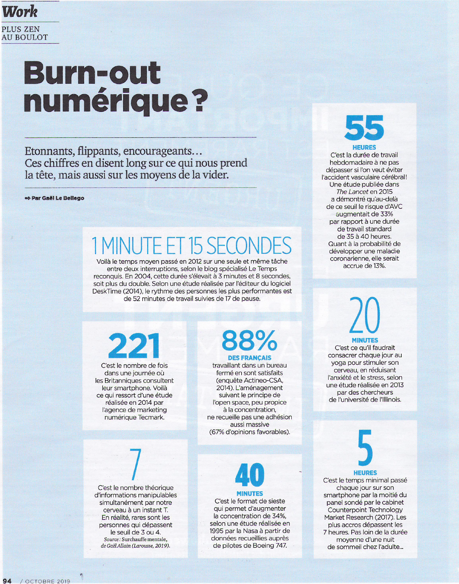
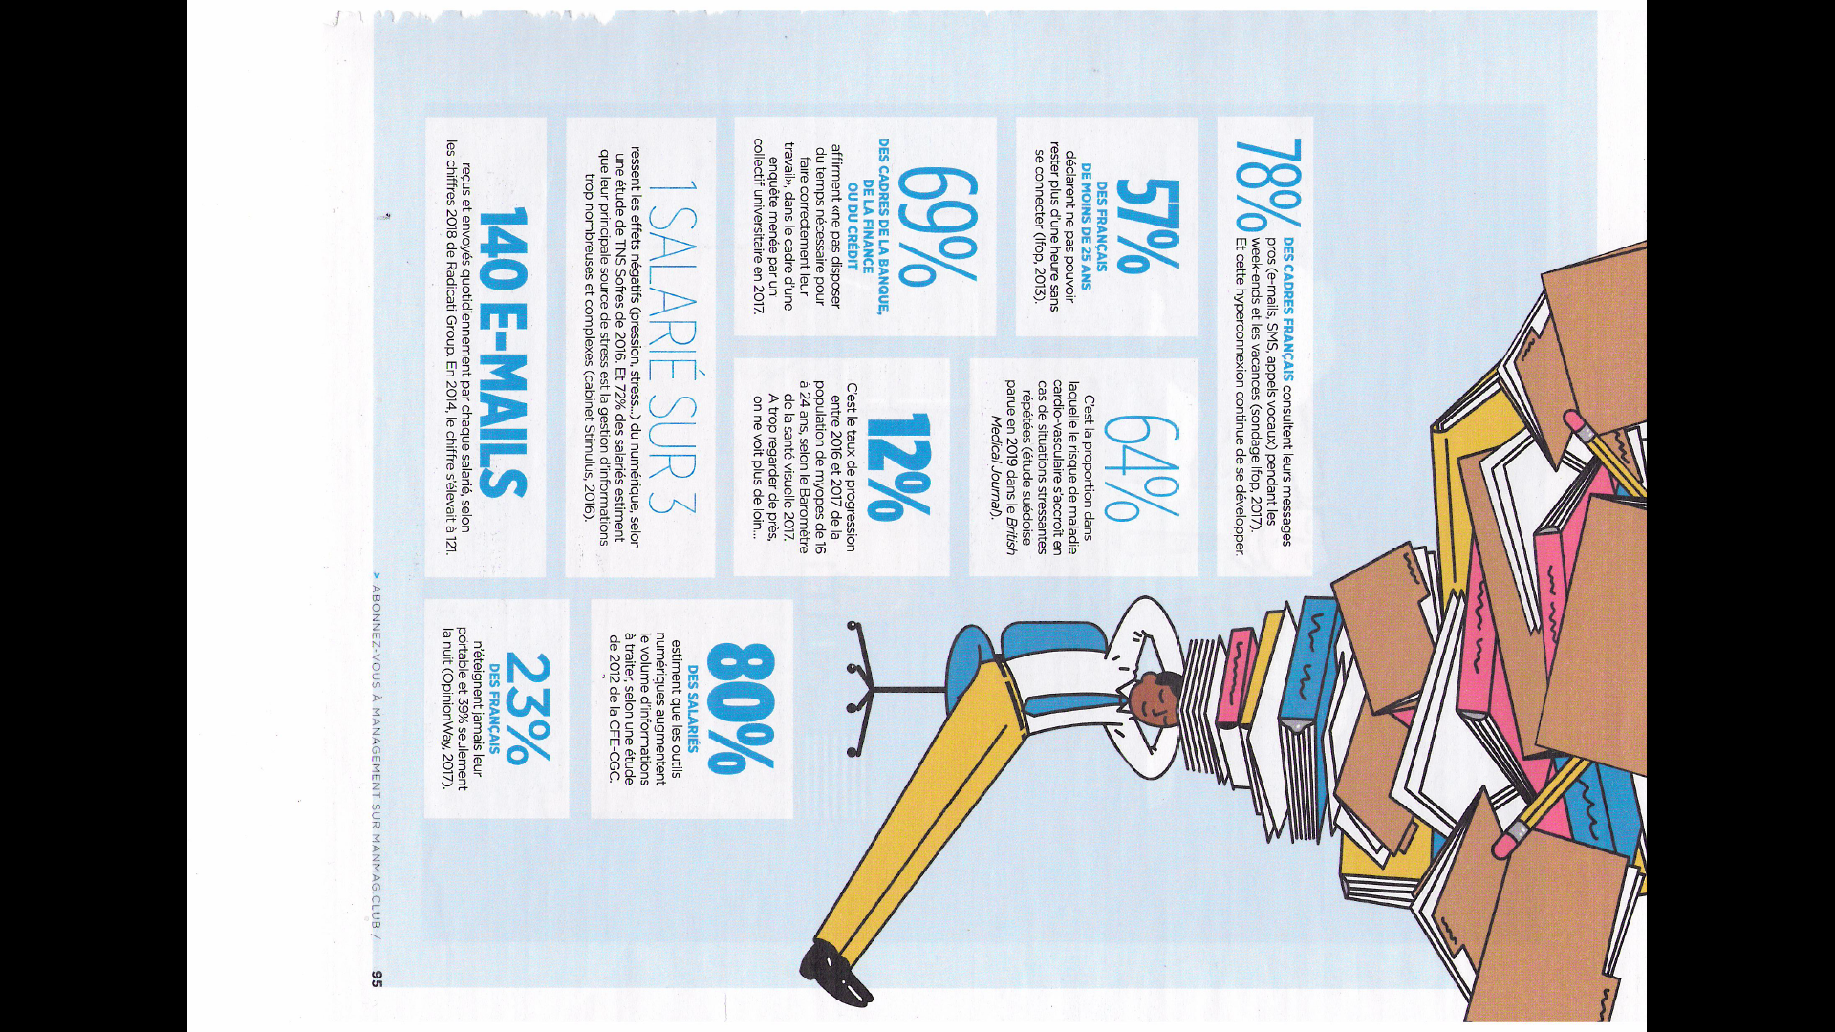
Management –

Slide 4
Direct Matin – © Christophe Grippay – HR CONSEIL

Slide 5
Dynamique Entrepreneuriale -

Slide 6
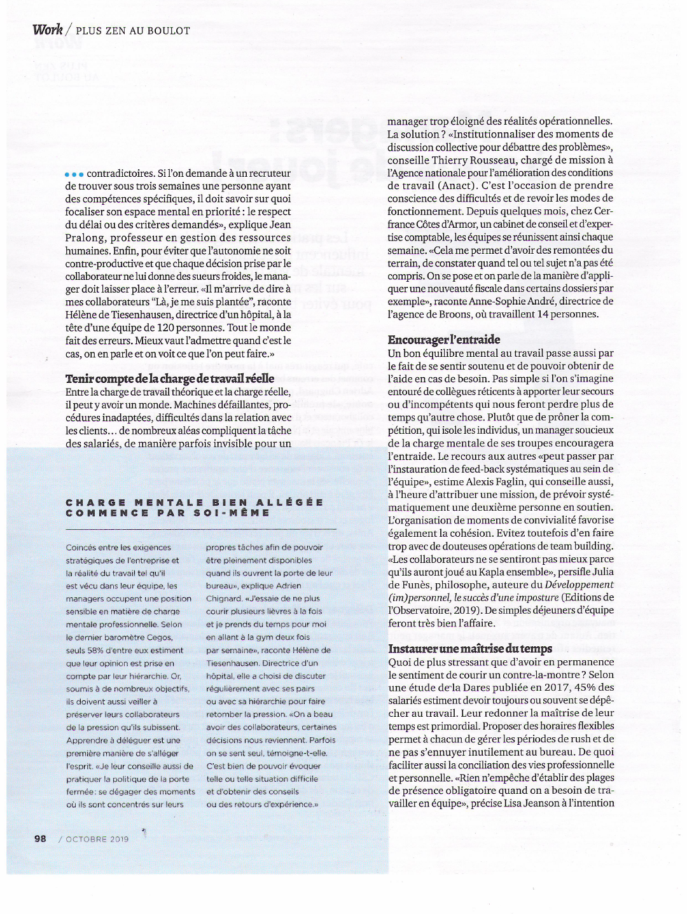
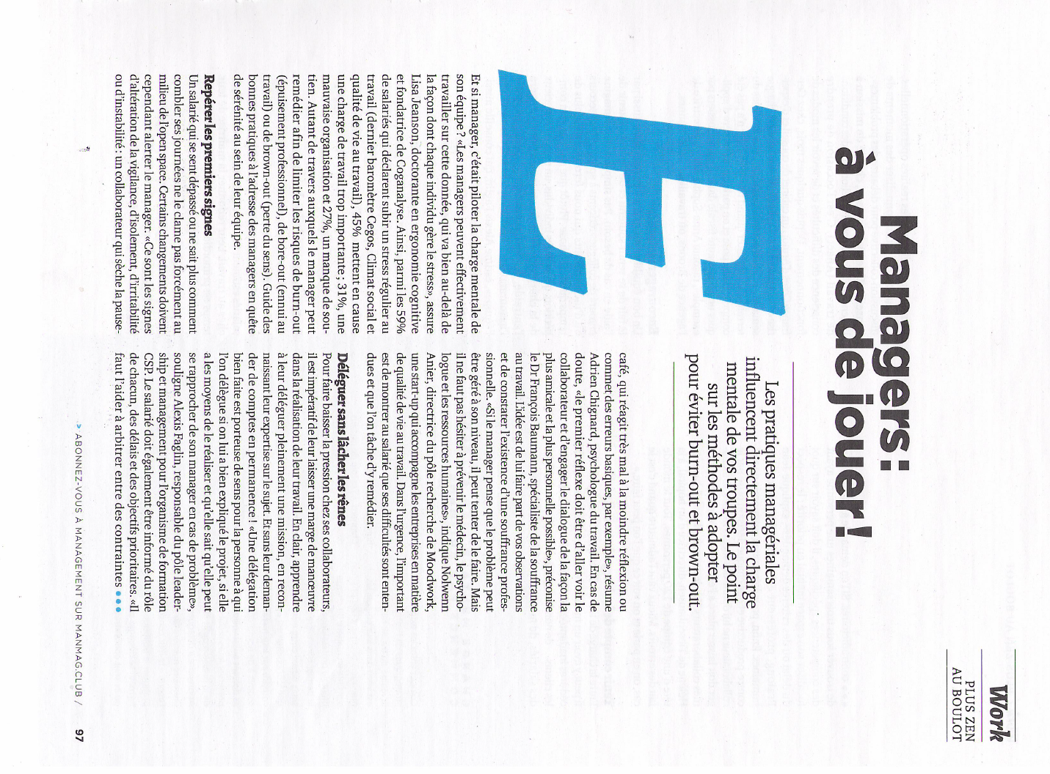
Management –

Slide 7
Management –

Slide 8
Management

Slide 9
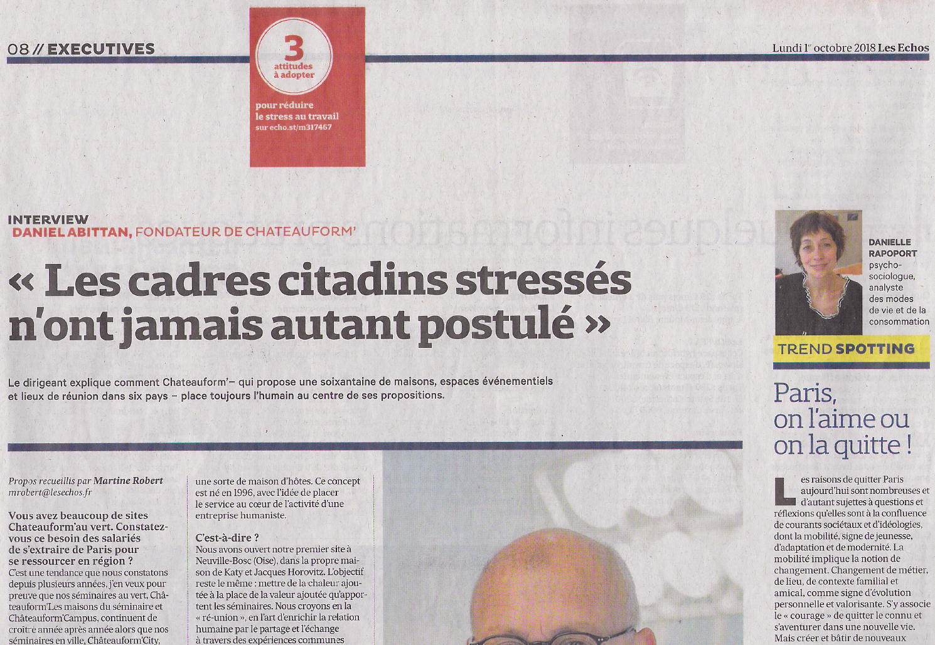
Les Echos

Slide 10
Les Echos

Slide 11
Harvard Business Review

Slide 12
Harvard Business Review

Slide 13
Management

Slide 14
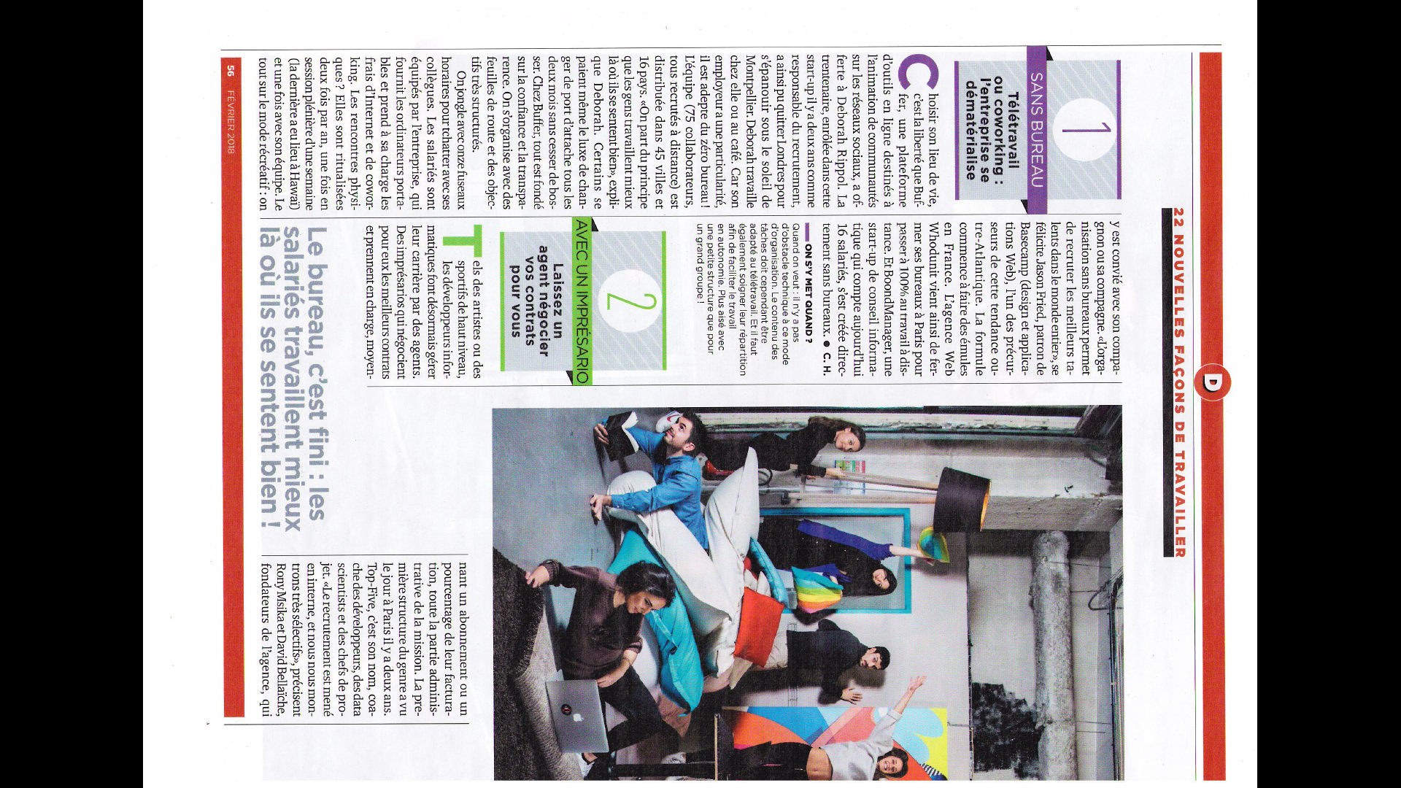
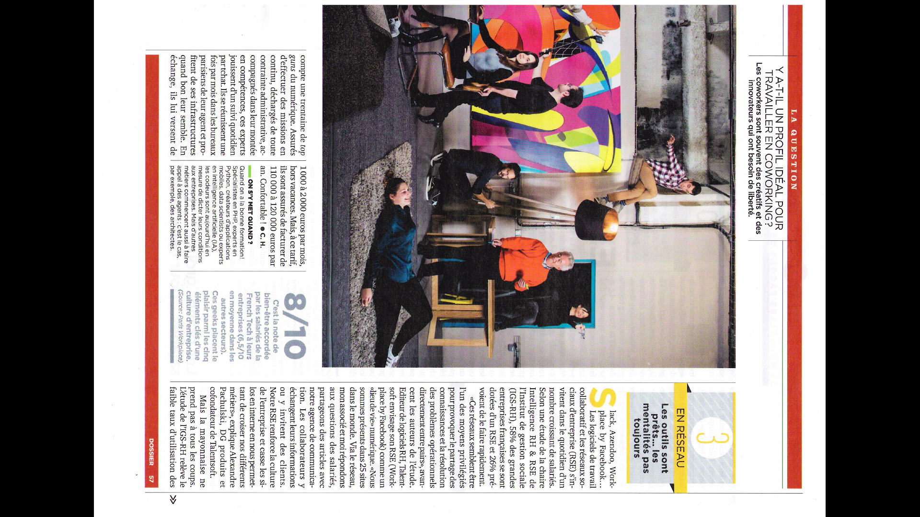
Management

Slide 15
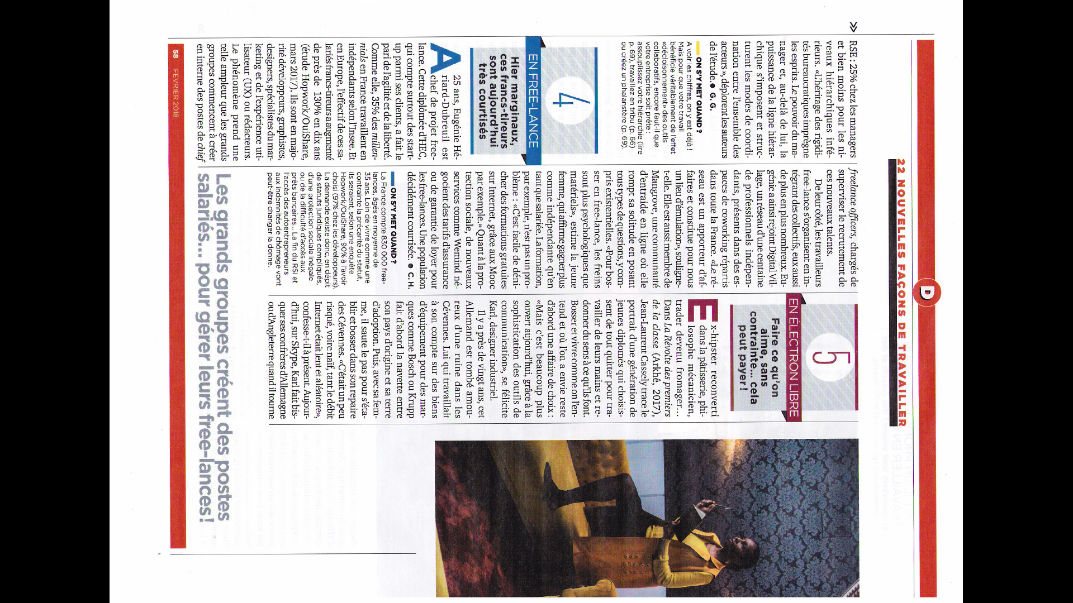
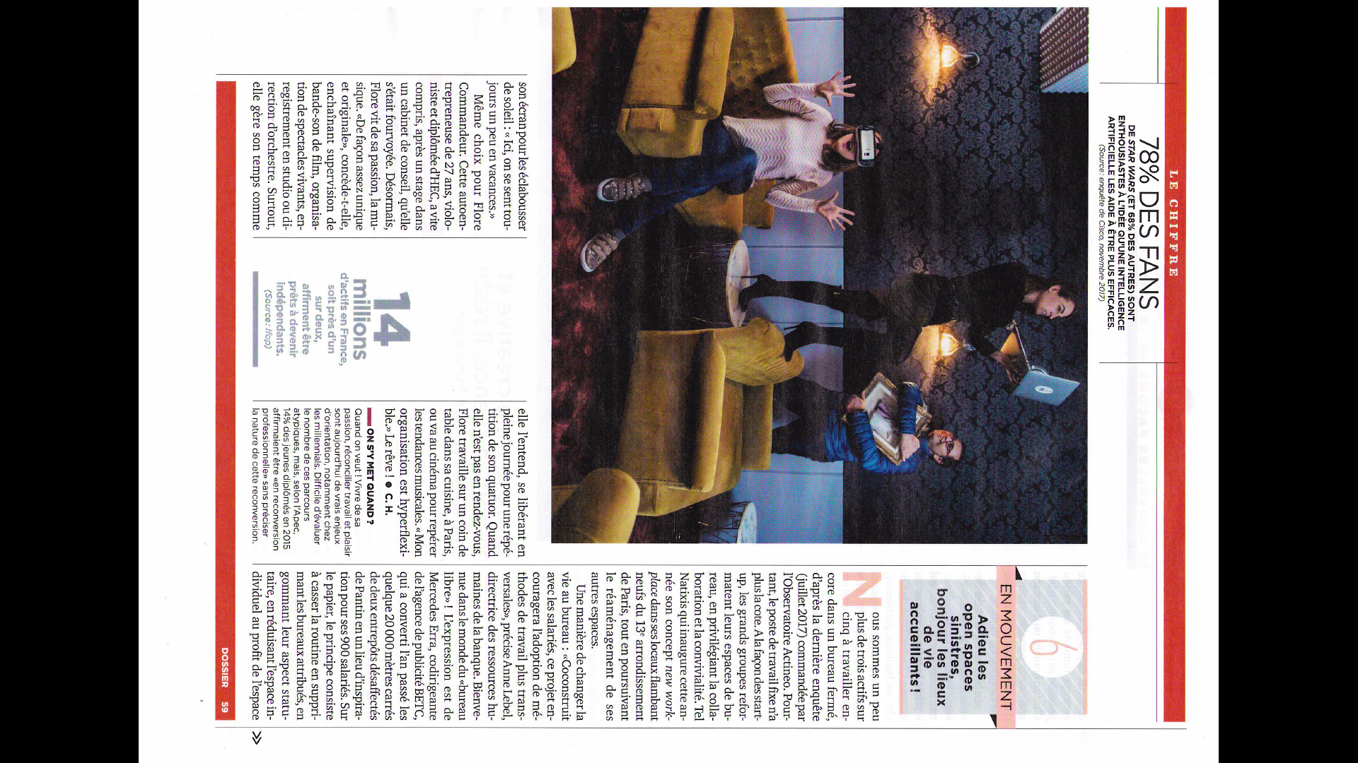
Management

Slide 16
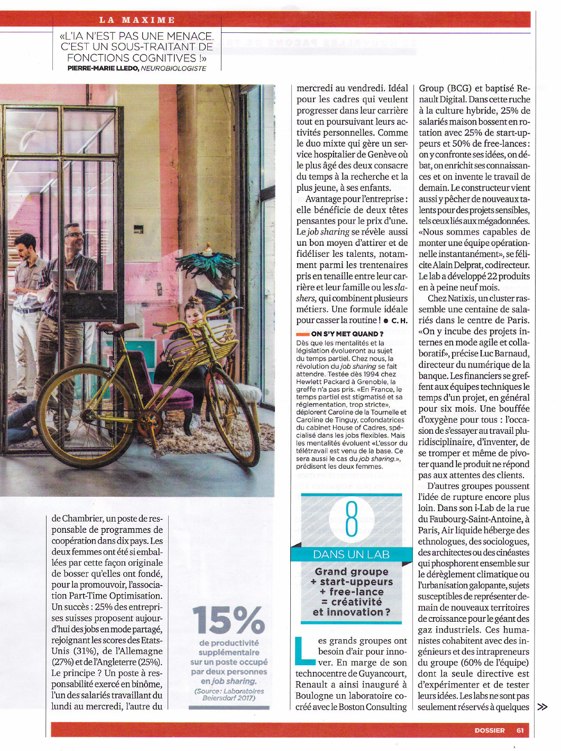
Management

Slide 17
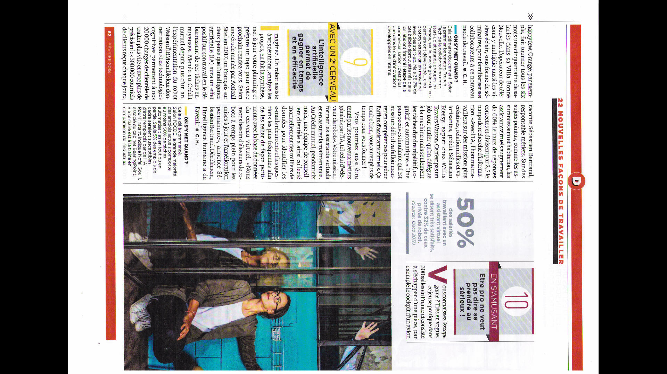
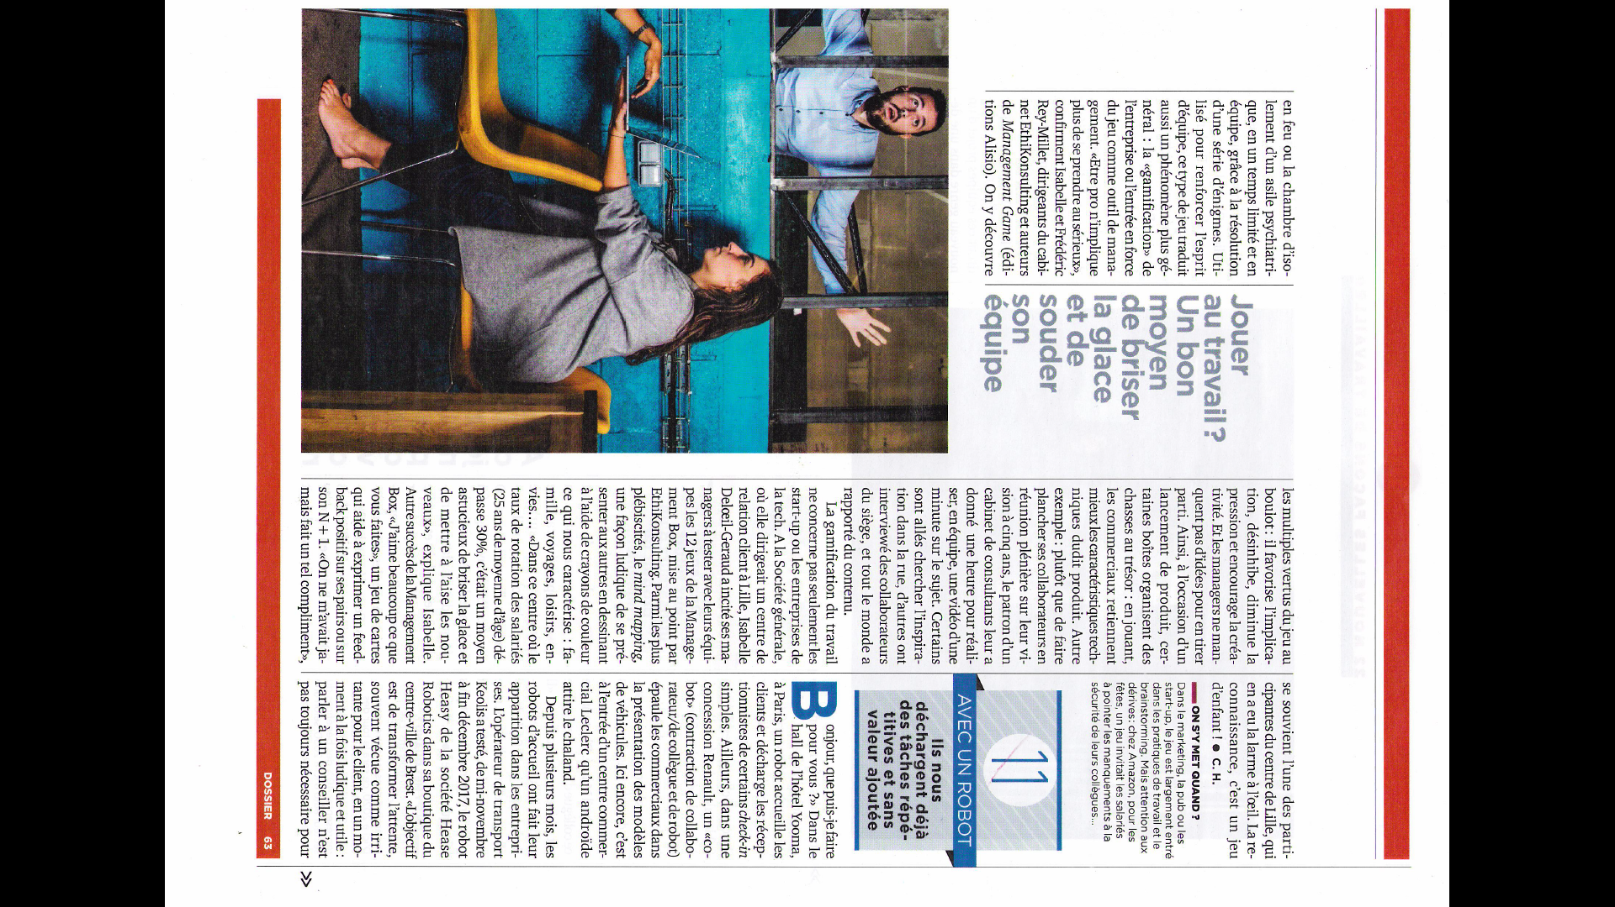
Management

Slide 18
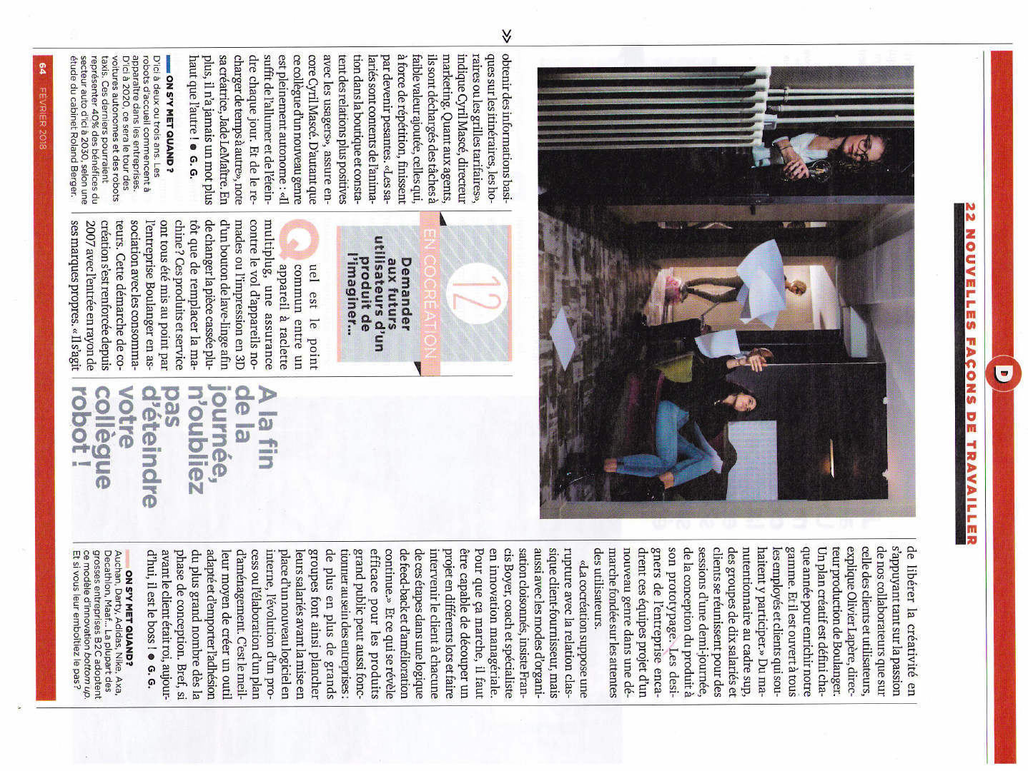
Management

Slide 19
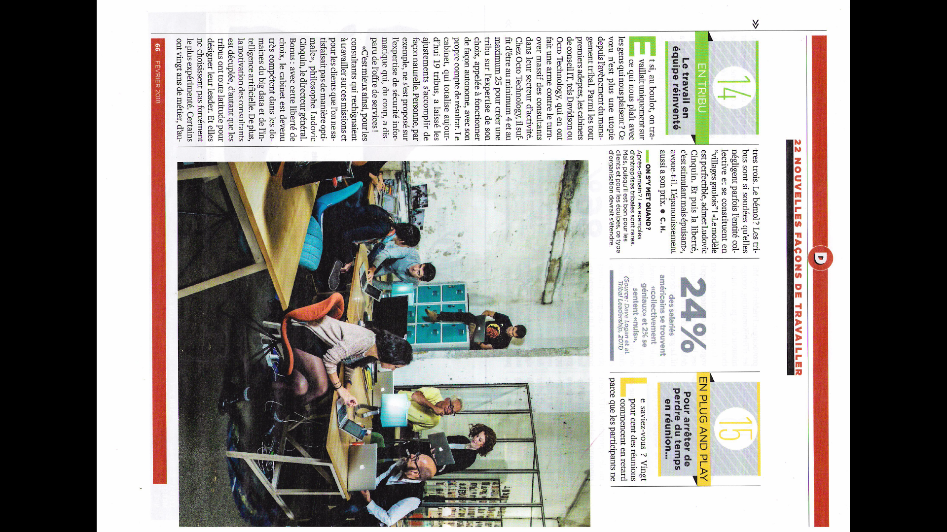
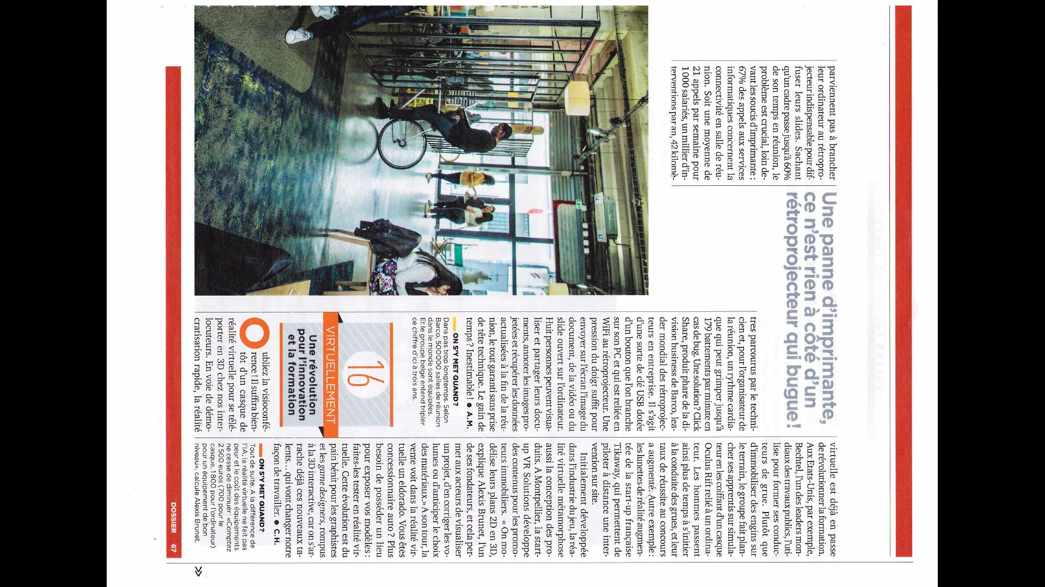
Management

Slide 20
Management

