Slide 2
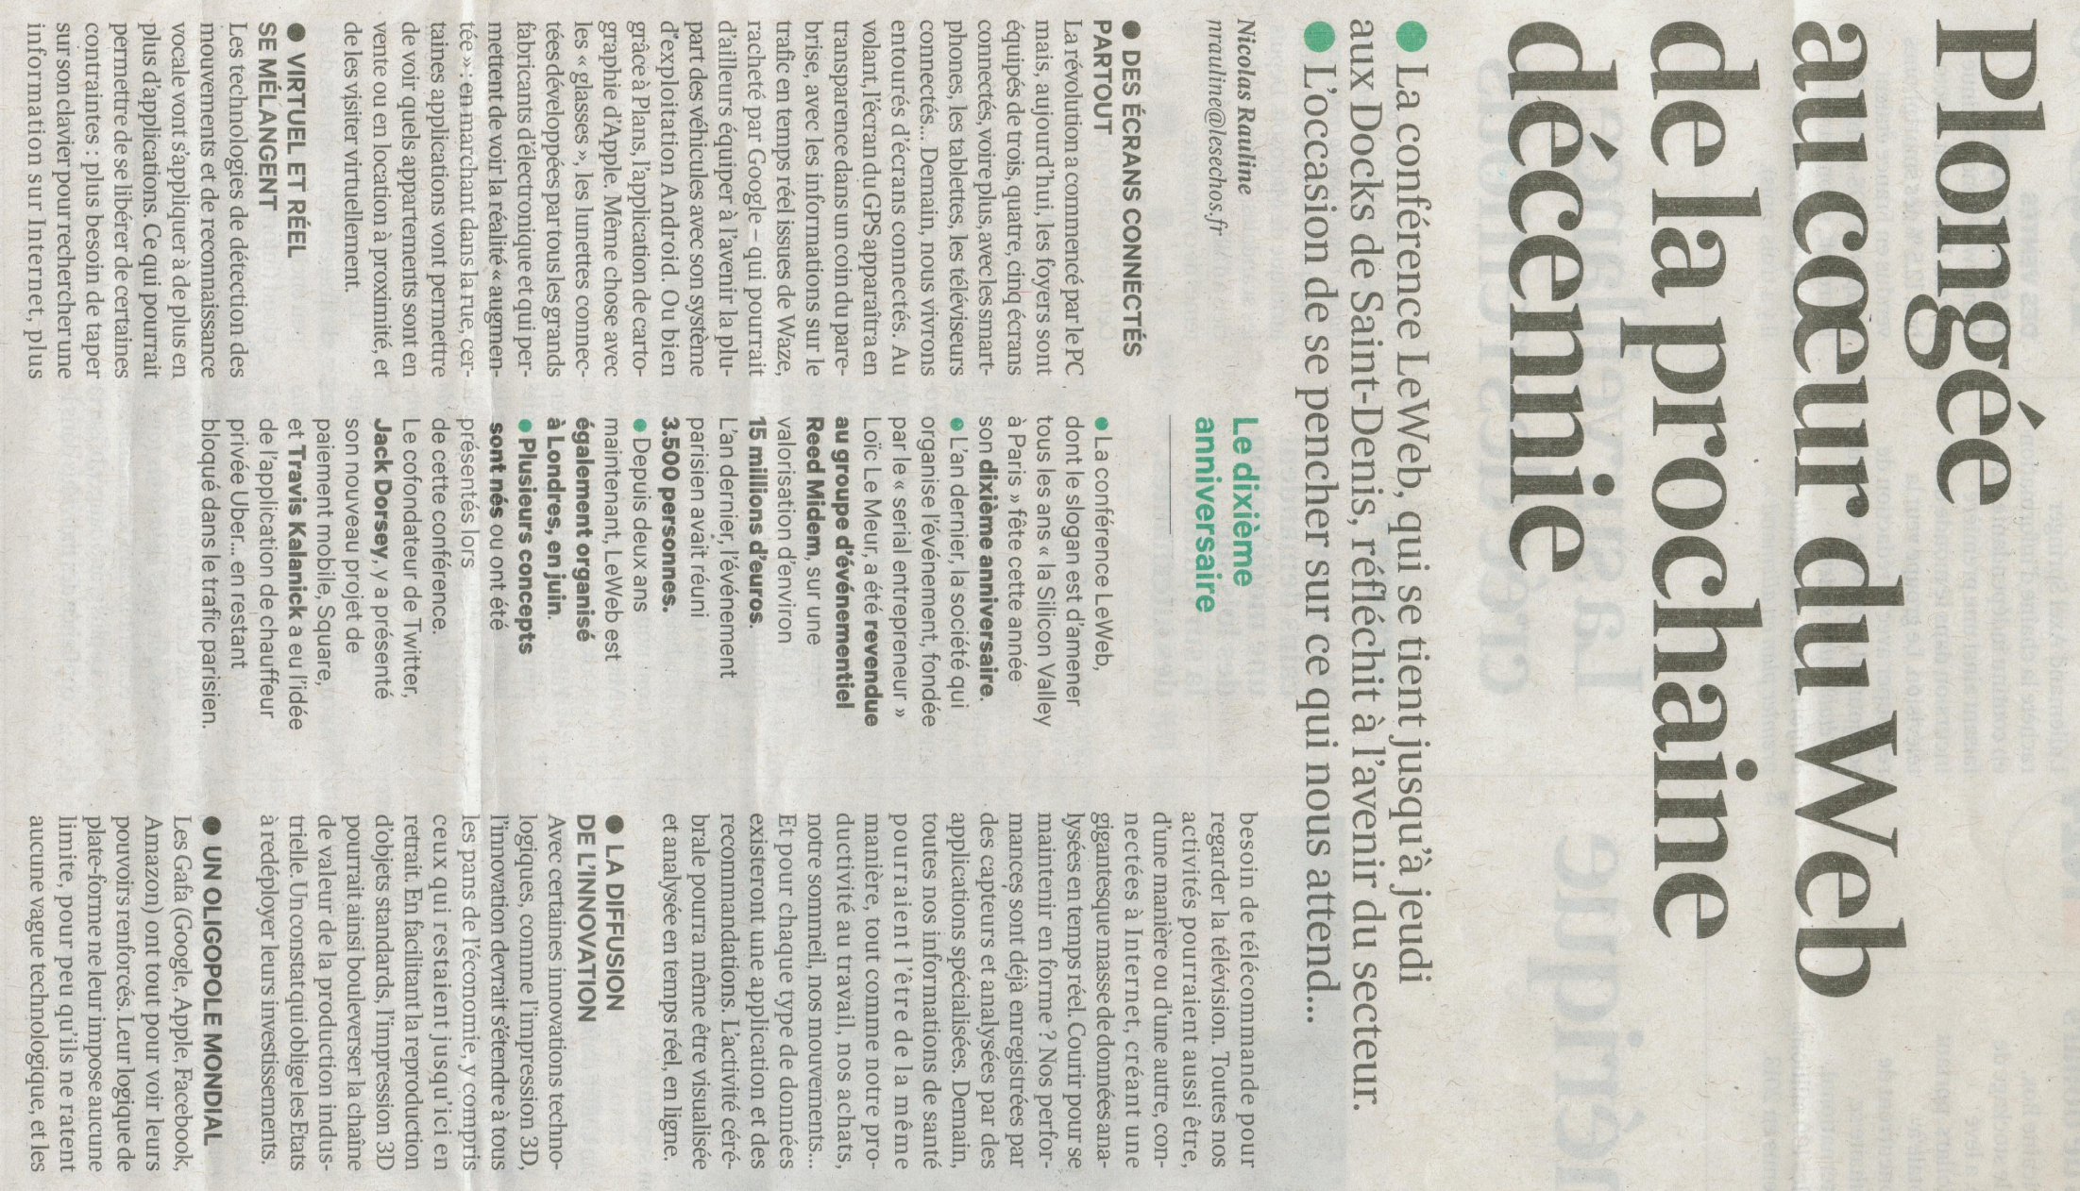
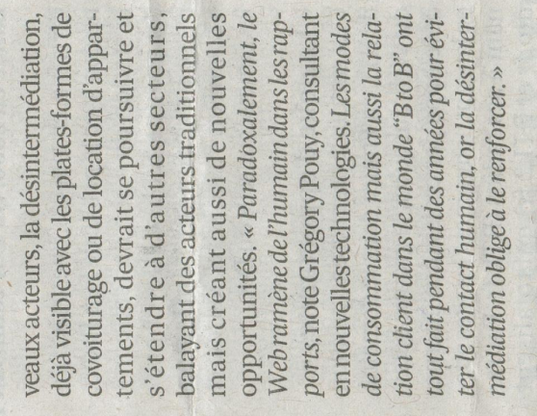

Slide 3
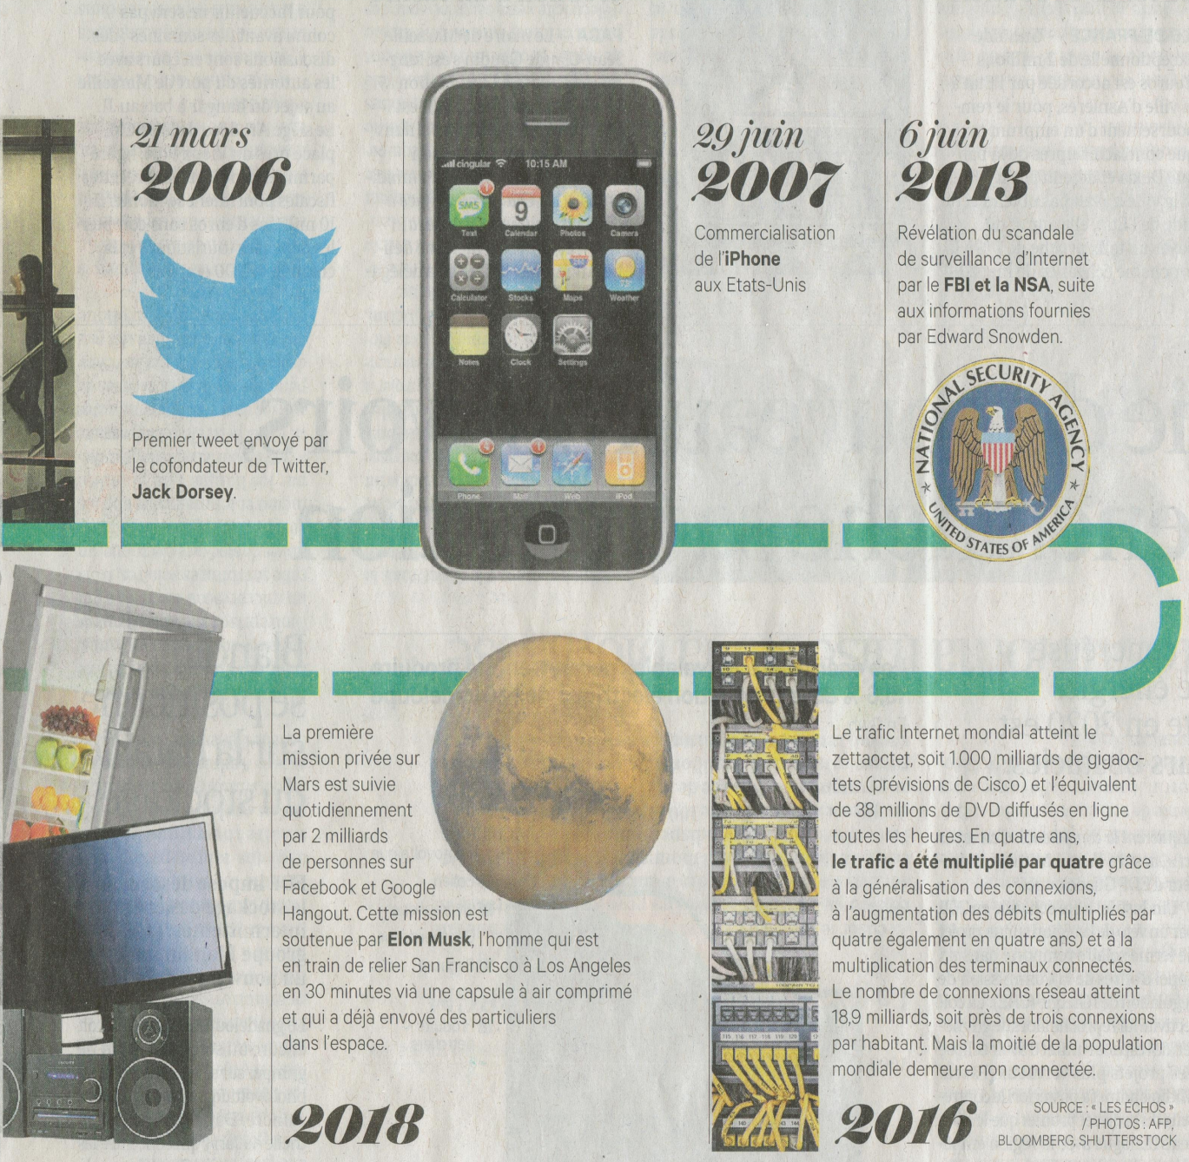
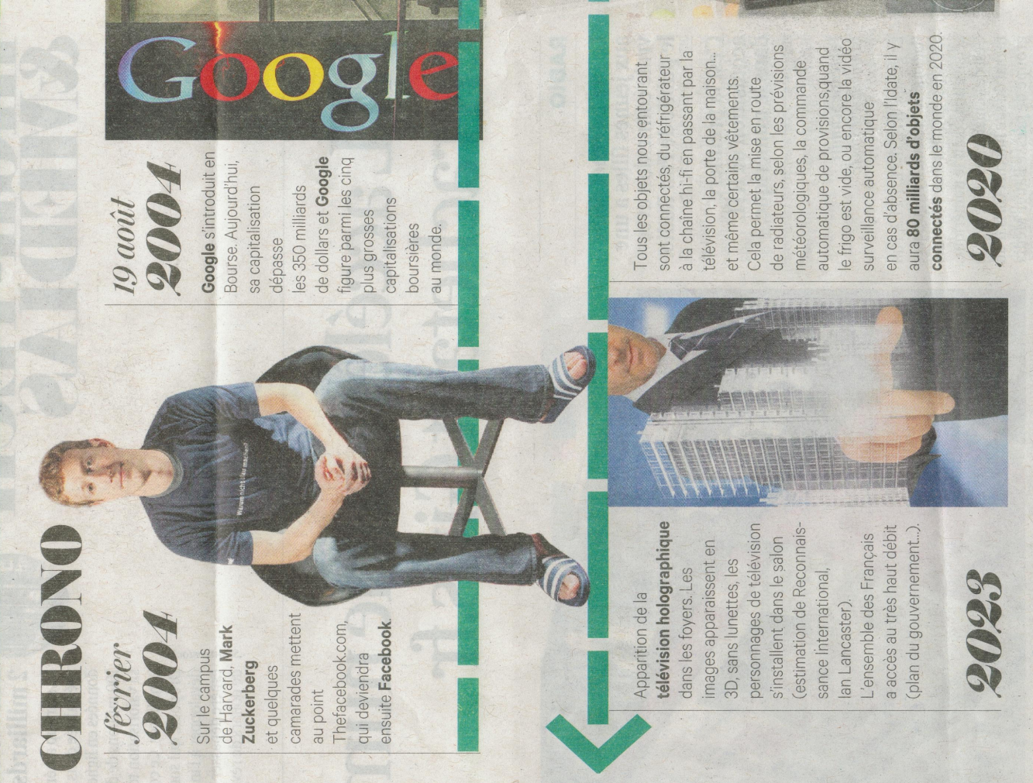

Slide 4
Management–

Slide 5
Enjeux Les Echos –

Slide 6
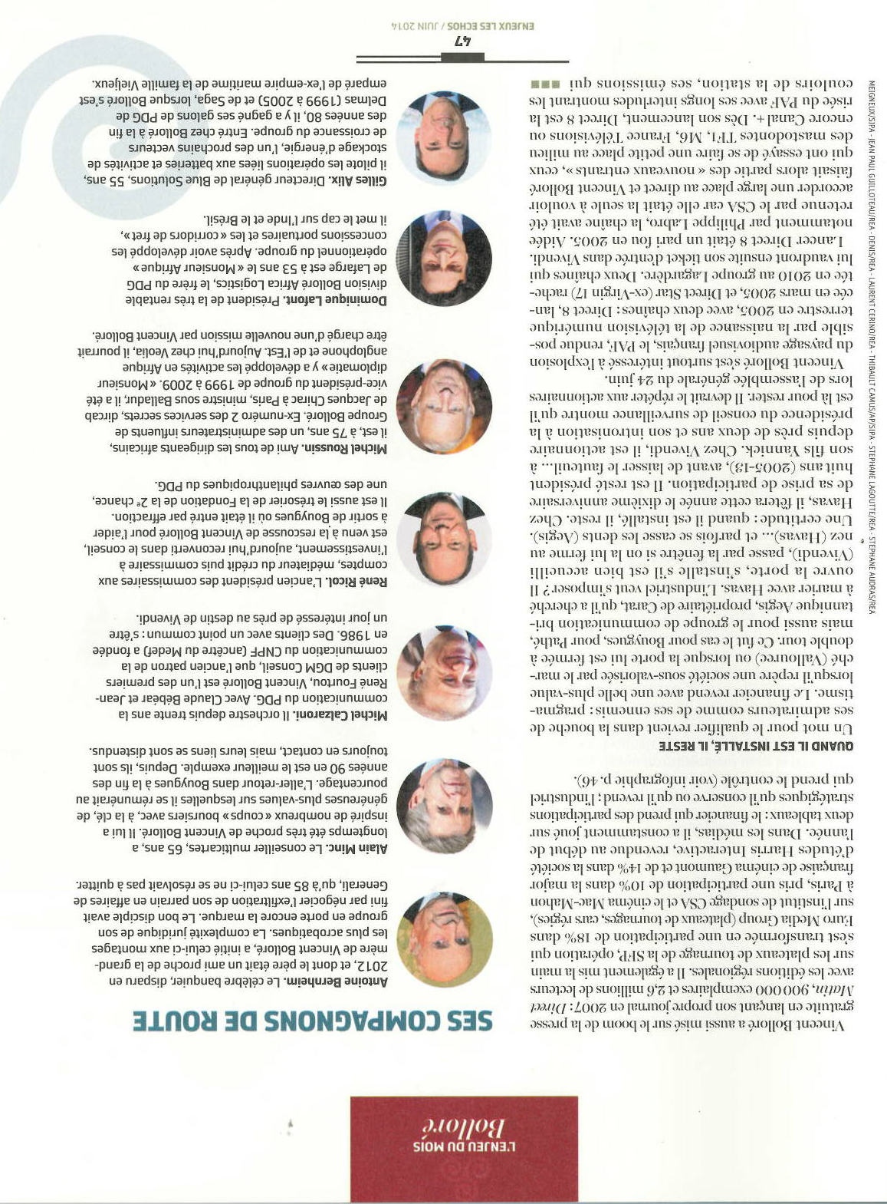
Enjeux Les Echos –

Slide 7
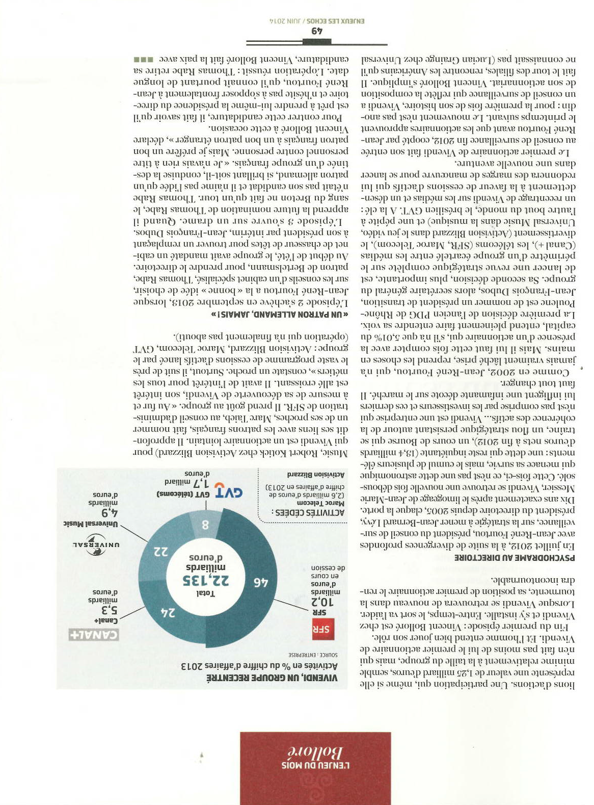
Enjeux Les Echos –

Slide 8
Enjeux Les Echos –

Slide 9
Pourquoi ce sujet est important
Enjeux Les Echos –

Slide 10
Les Echos –

Slide 12
Management –

Slide 13
Management –

Slide 14
Management –

Slide 15
Management –

Slide 16
Management –

Slide 17
Management –

Slide 18
Management –

Slide 19
Management –

Slide 20
Management –

Slide 21
Management –

Slide 22
Management –

Slide 23
Les Echos –

Slide 24
Harvard Business Review –

Slide 25
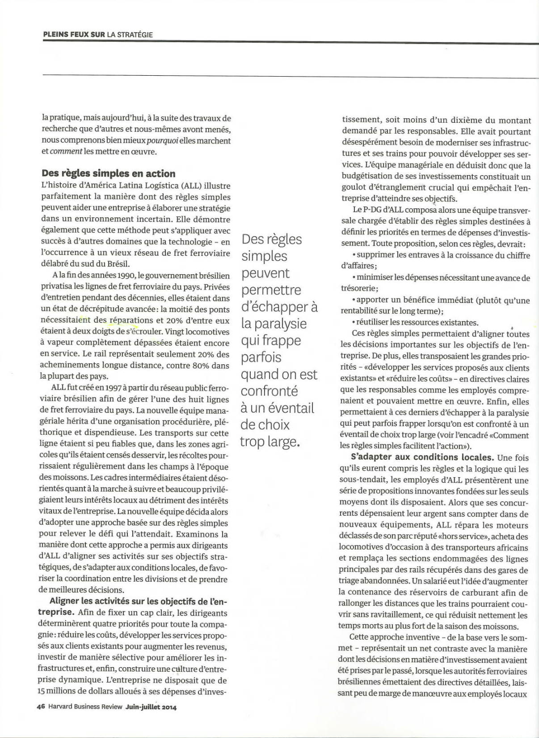
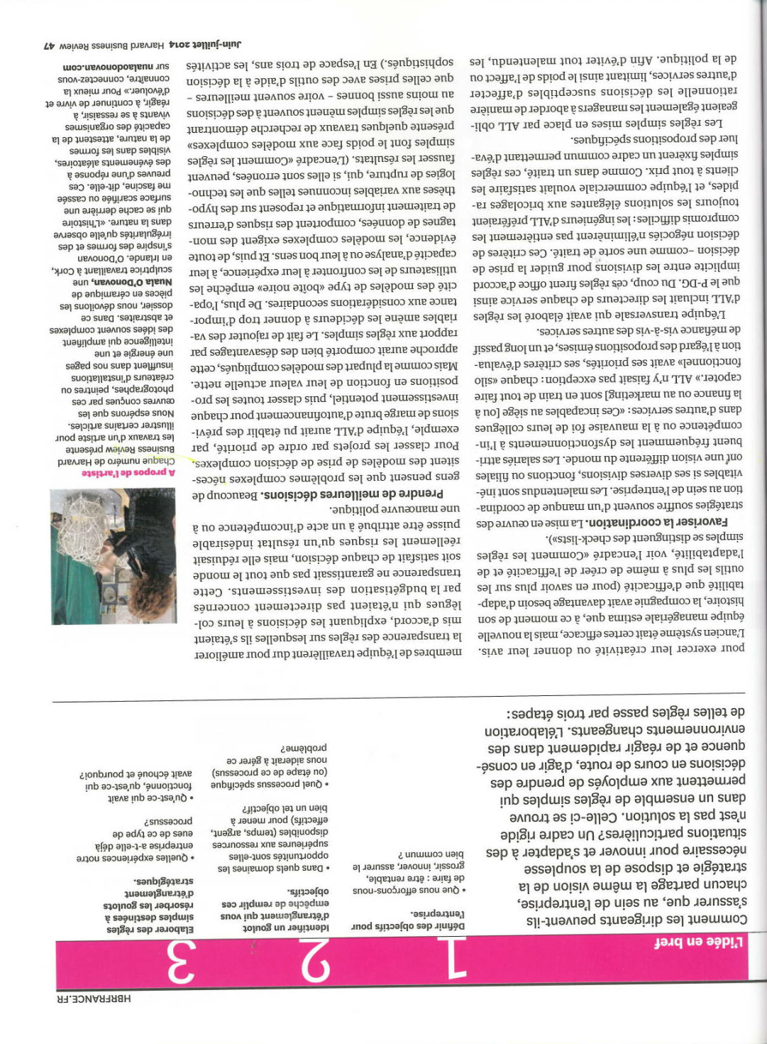
Harvard Business Review –

Slide 26
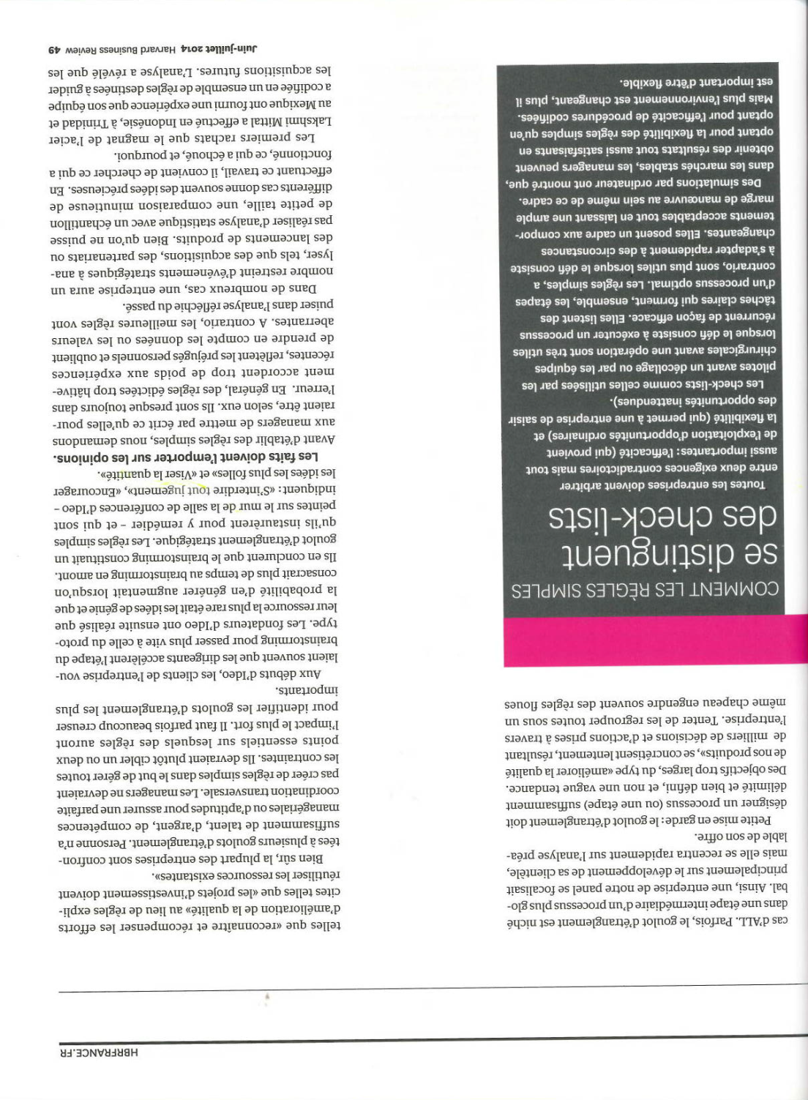
Harvard Business Review

Slide 27
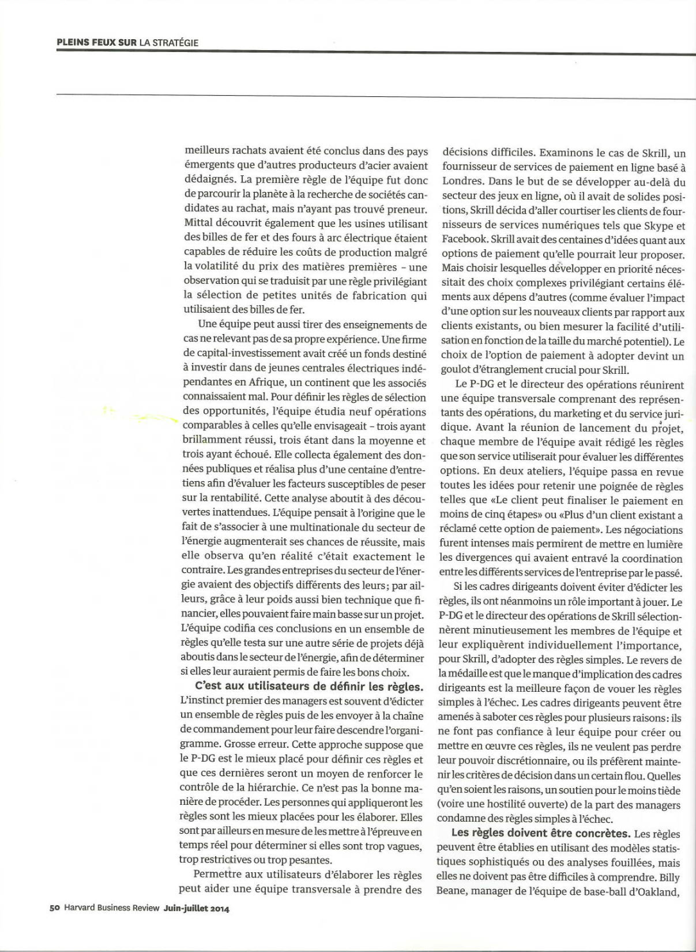
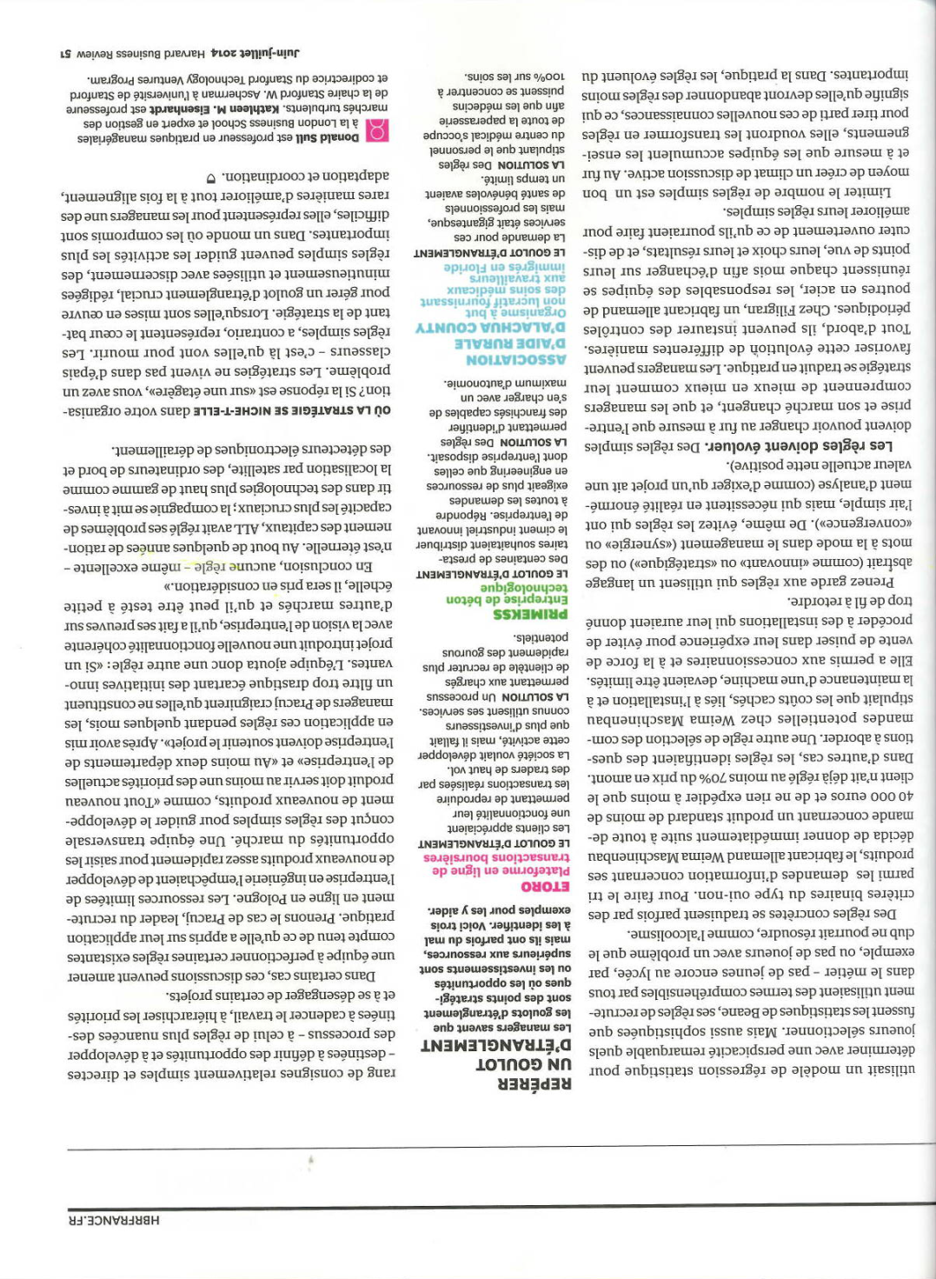
Harvard Business Review

Slide 28
Harvard Business Review –

Slide 29
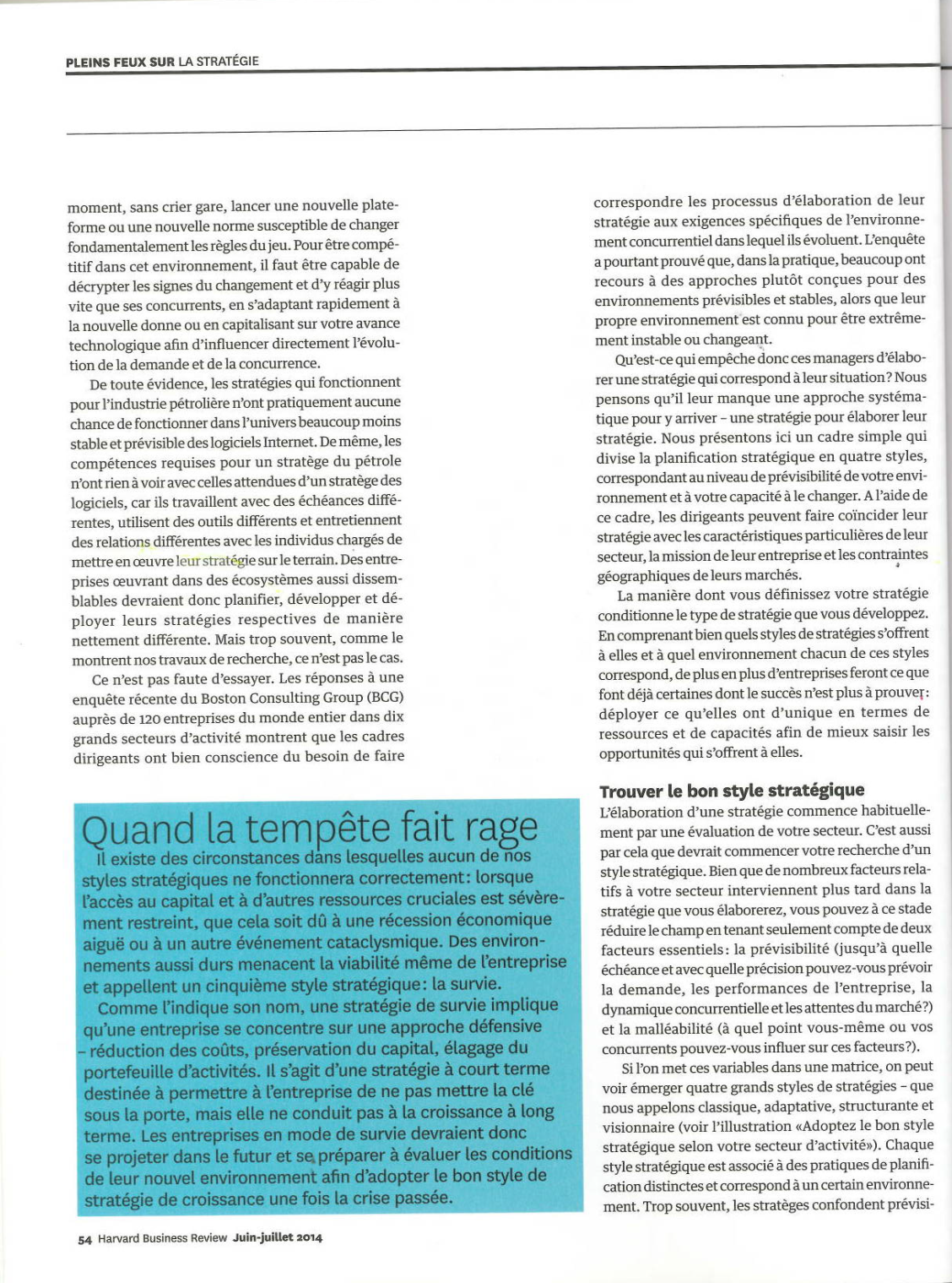
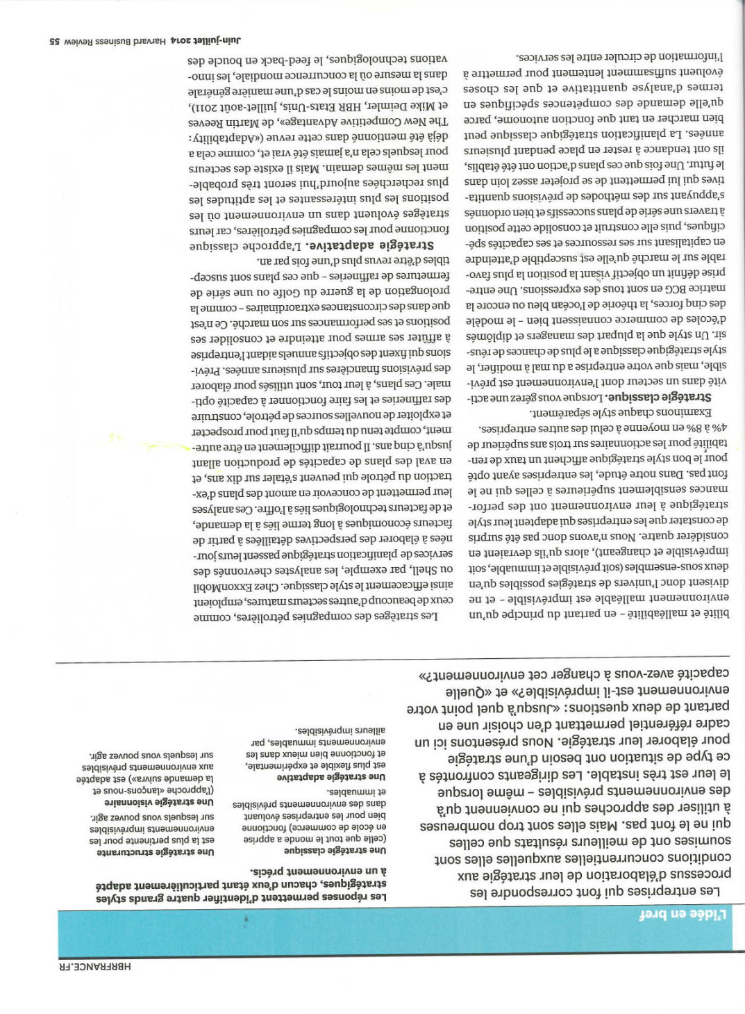
Harvard Business Review –

Slide 30
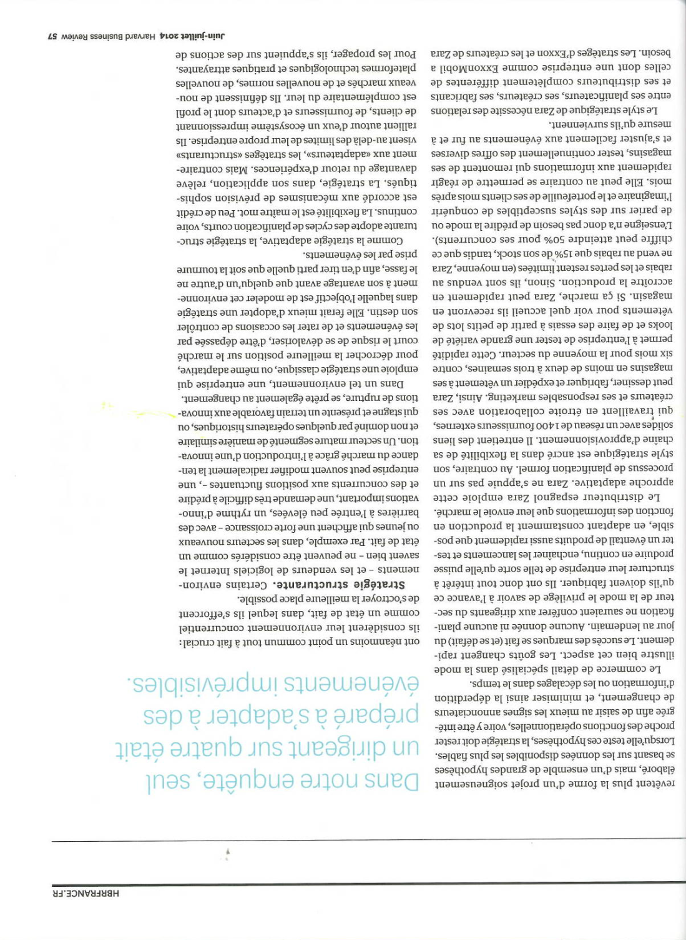
Harvard Business Review –

Slide 31
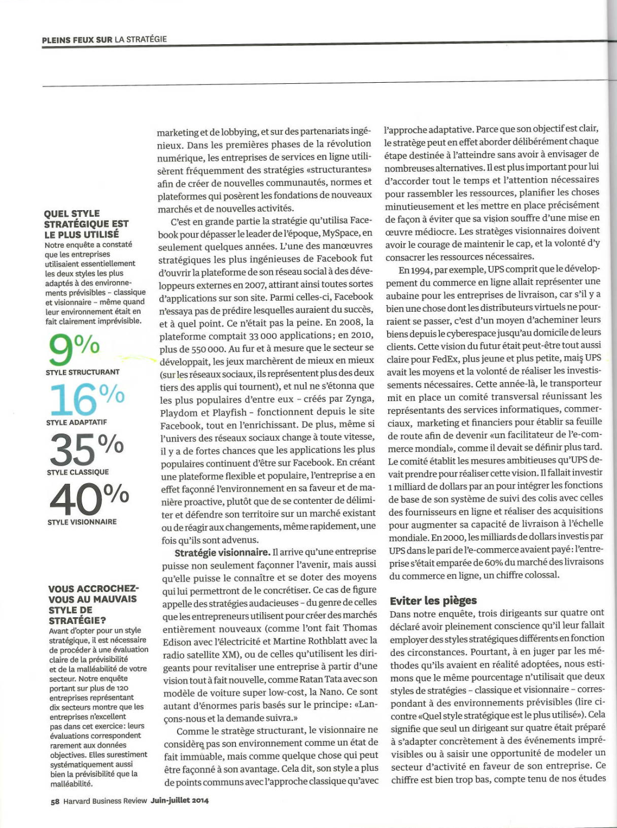
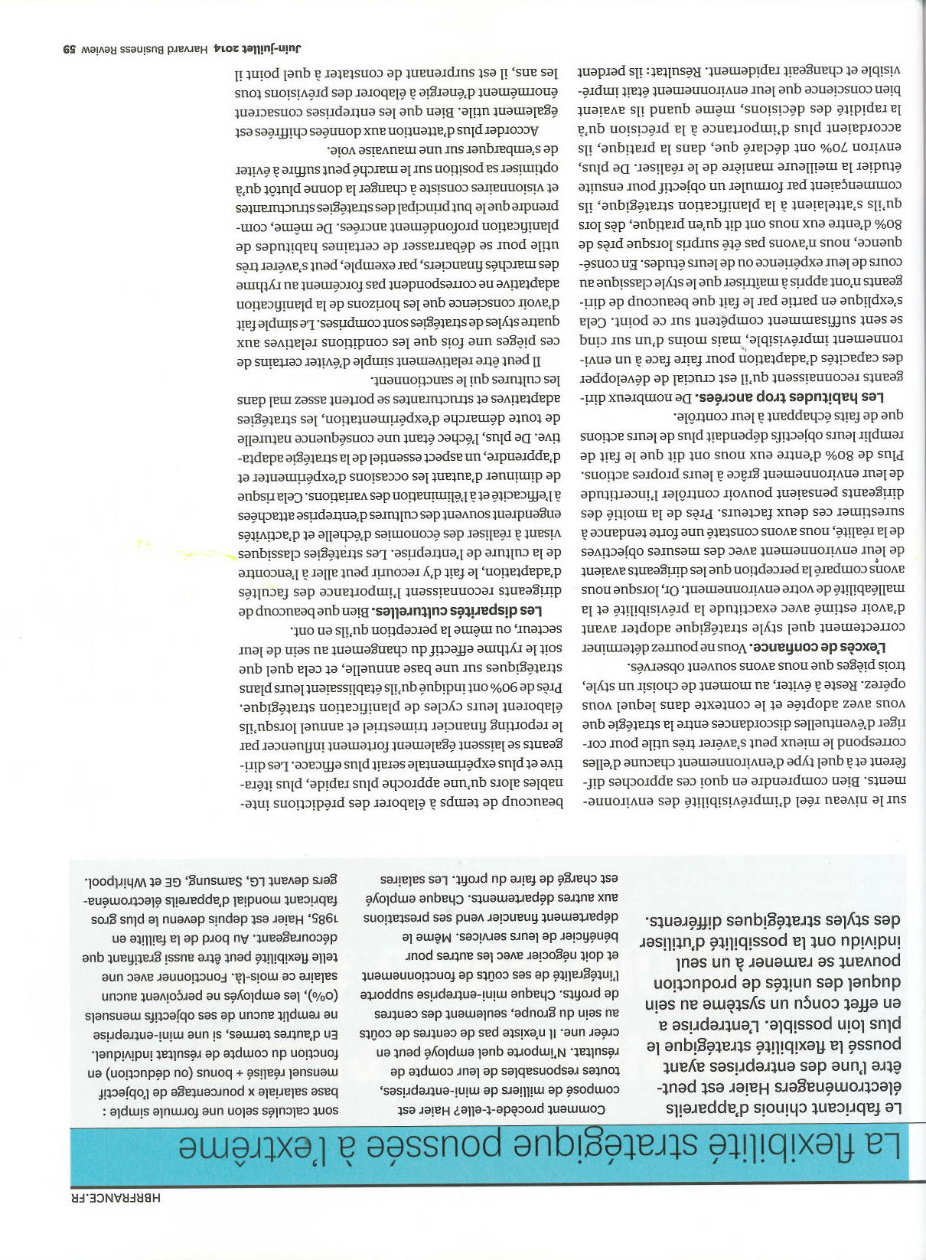
Harvard Business Review –

Slide 32
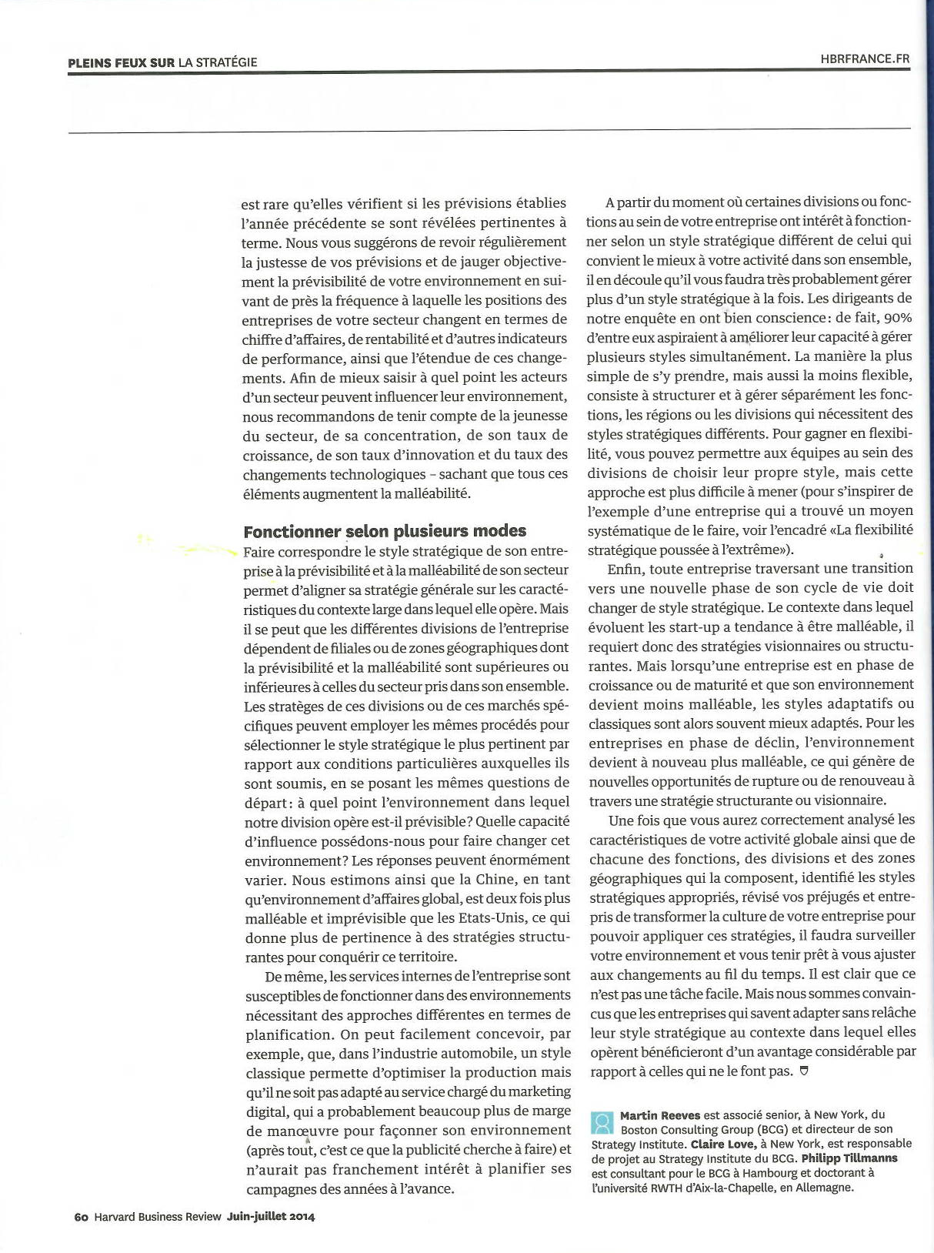
Harvard Business Review

