Slide 1
PFSF02B – Comment devenir un Chasseur de Stress

Slide 2
Management

Slide 3
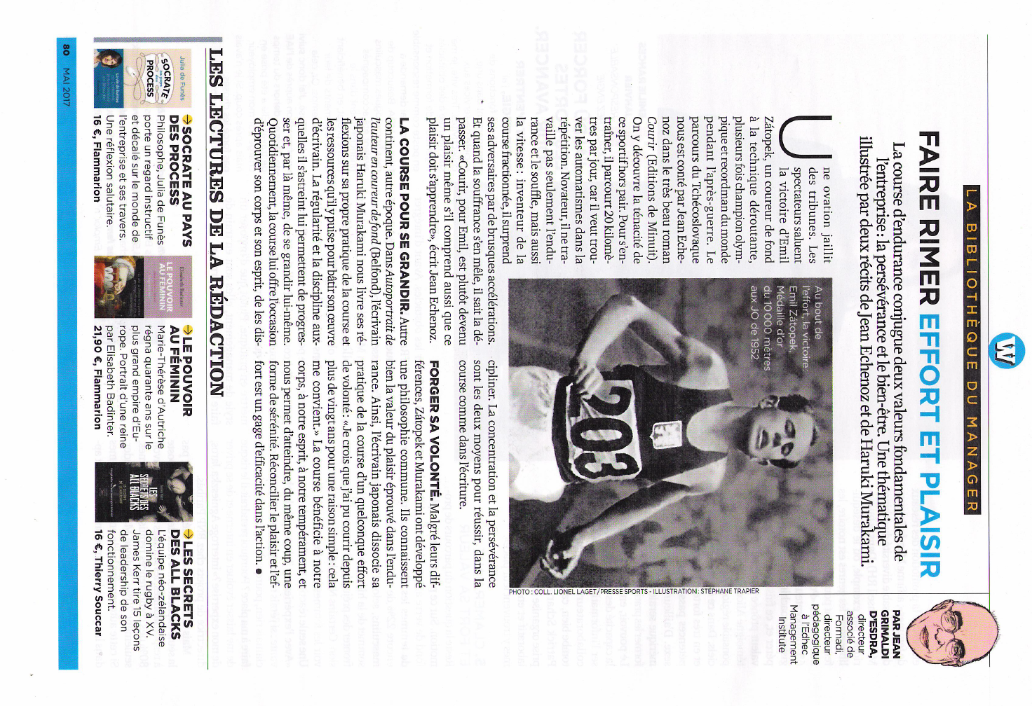
Management

Slide 4
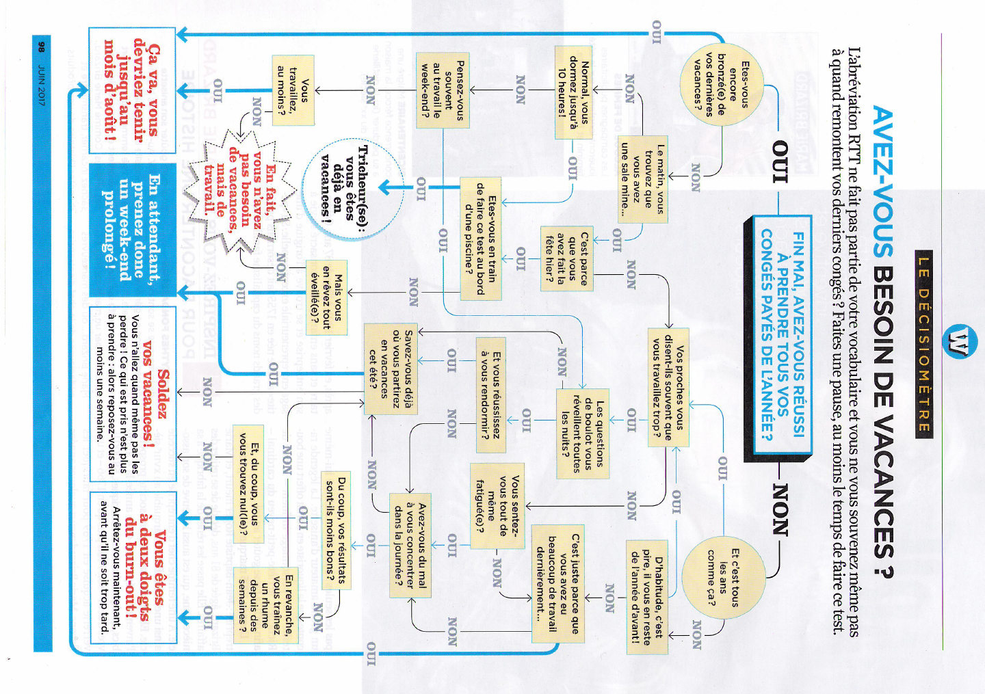
Management

Slide 5
Les Echos

Slide 6
Les Echos

Slide 7
Harvard Business Review

Slide 8
Harvard Business Review

Slide 9
Management

Slide 10
Management

Slide 11
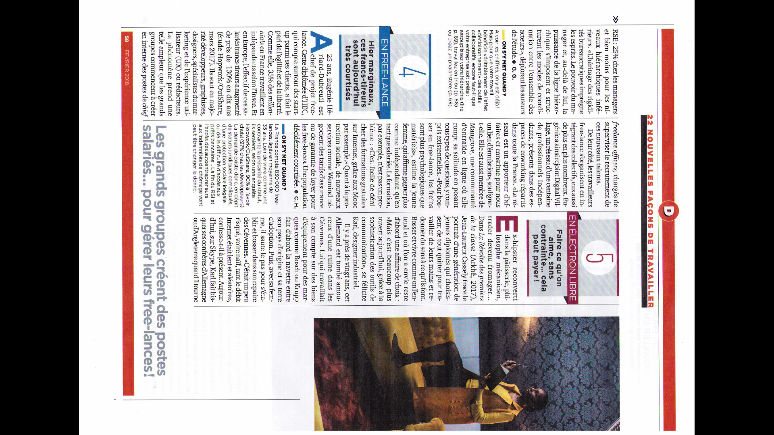
Management

Slide 12
Management

Slide 13
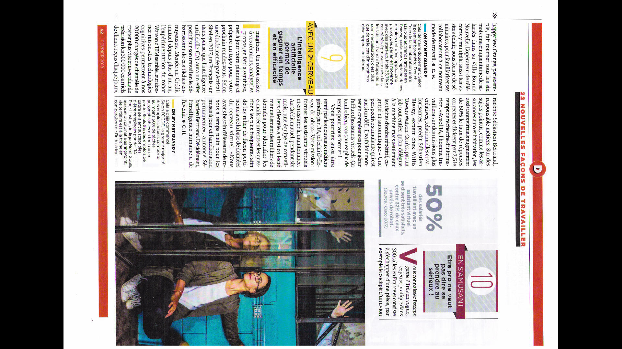
Management

Slide 14
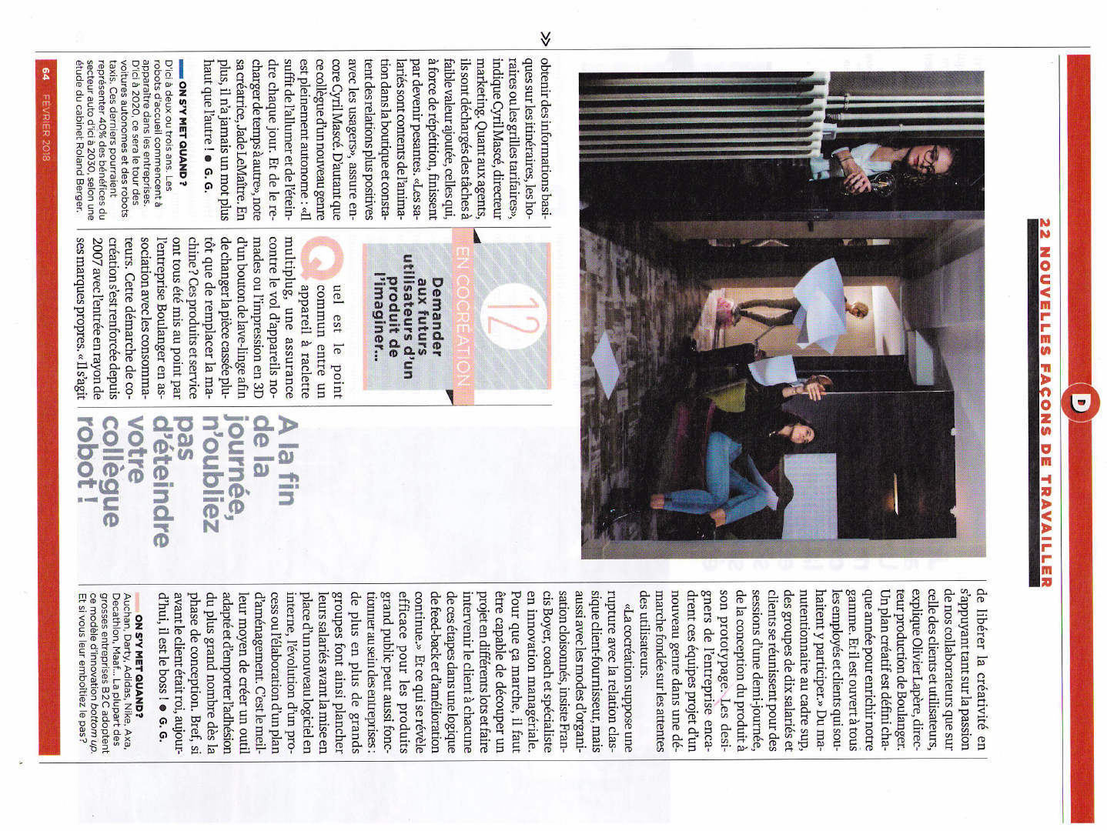
Management

Slide 15
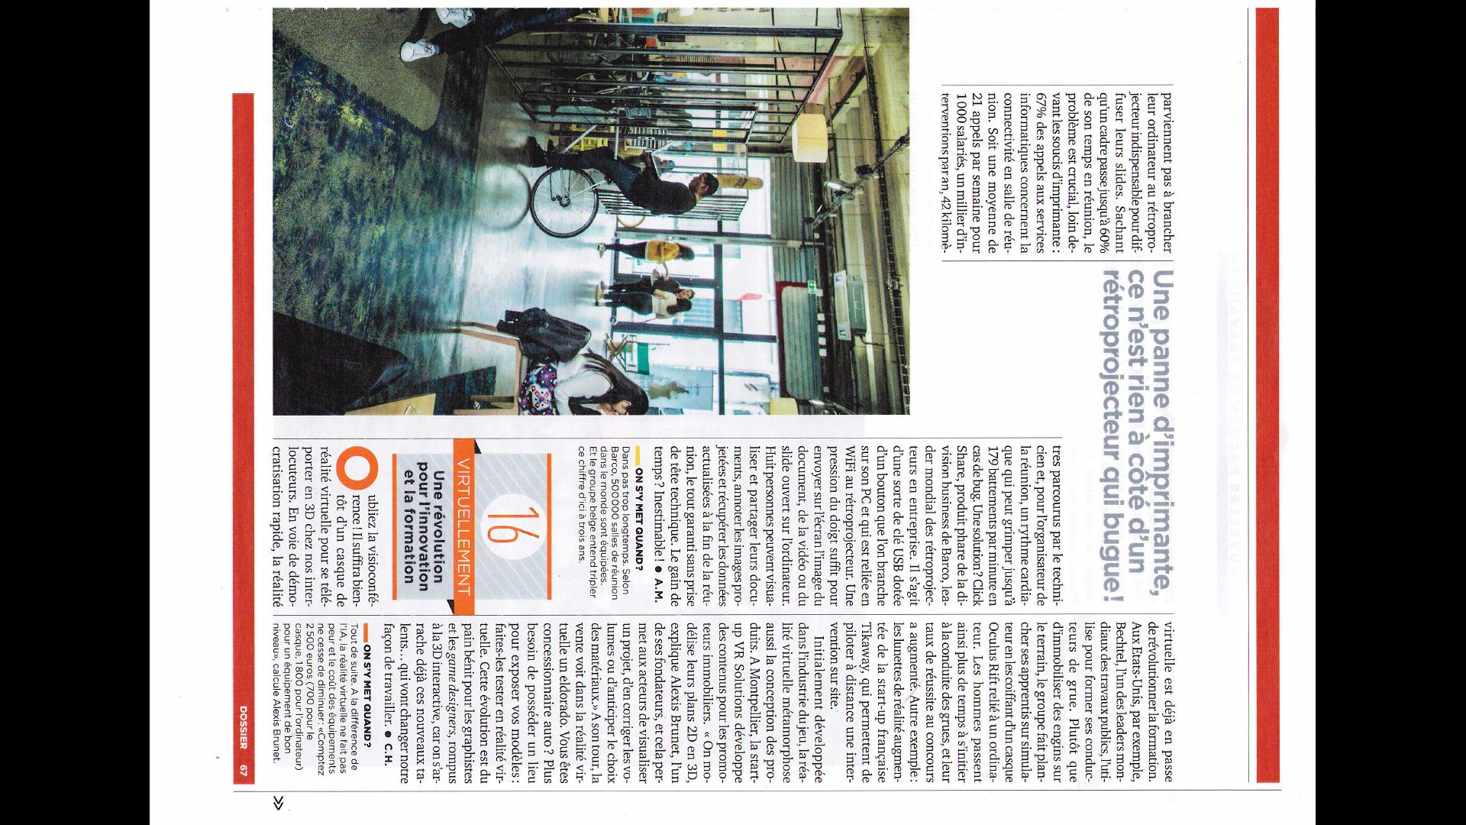
Management

Slide 16
Management

Slide 17
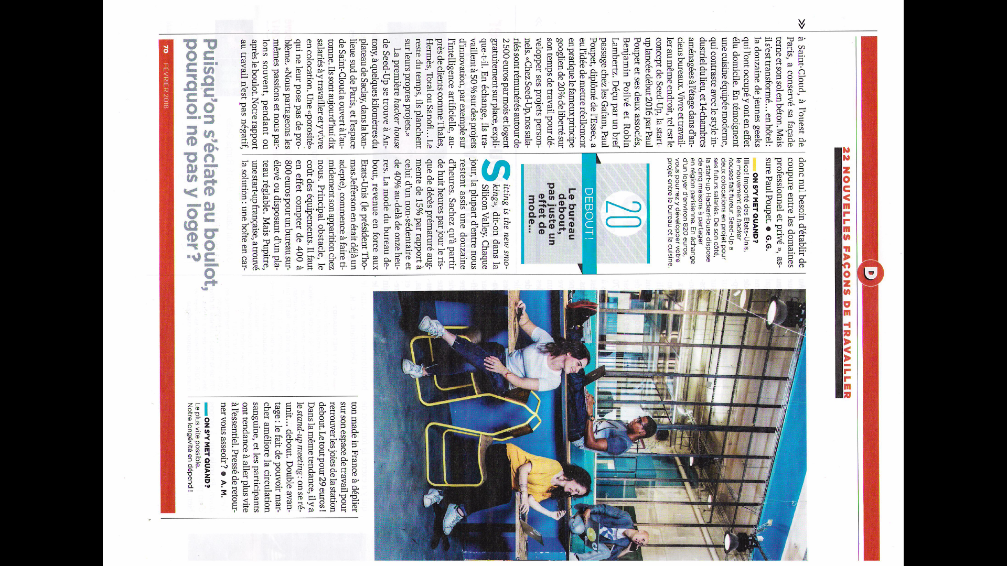
Management

Slide 18
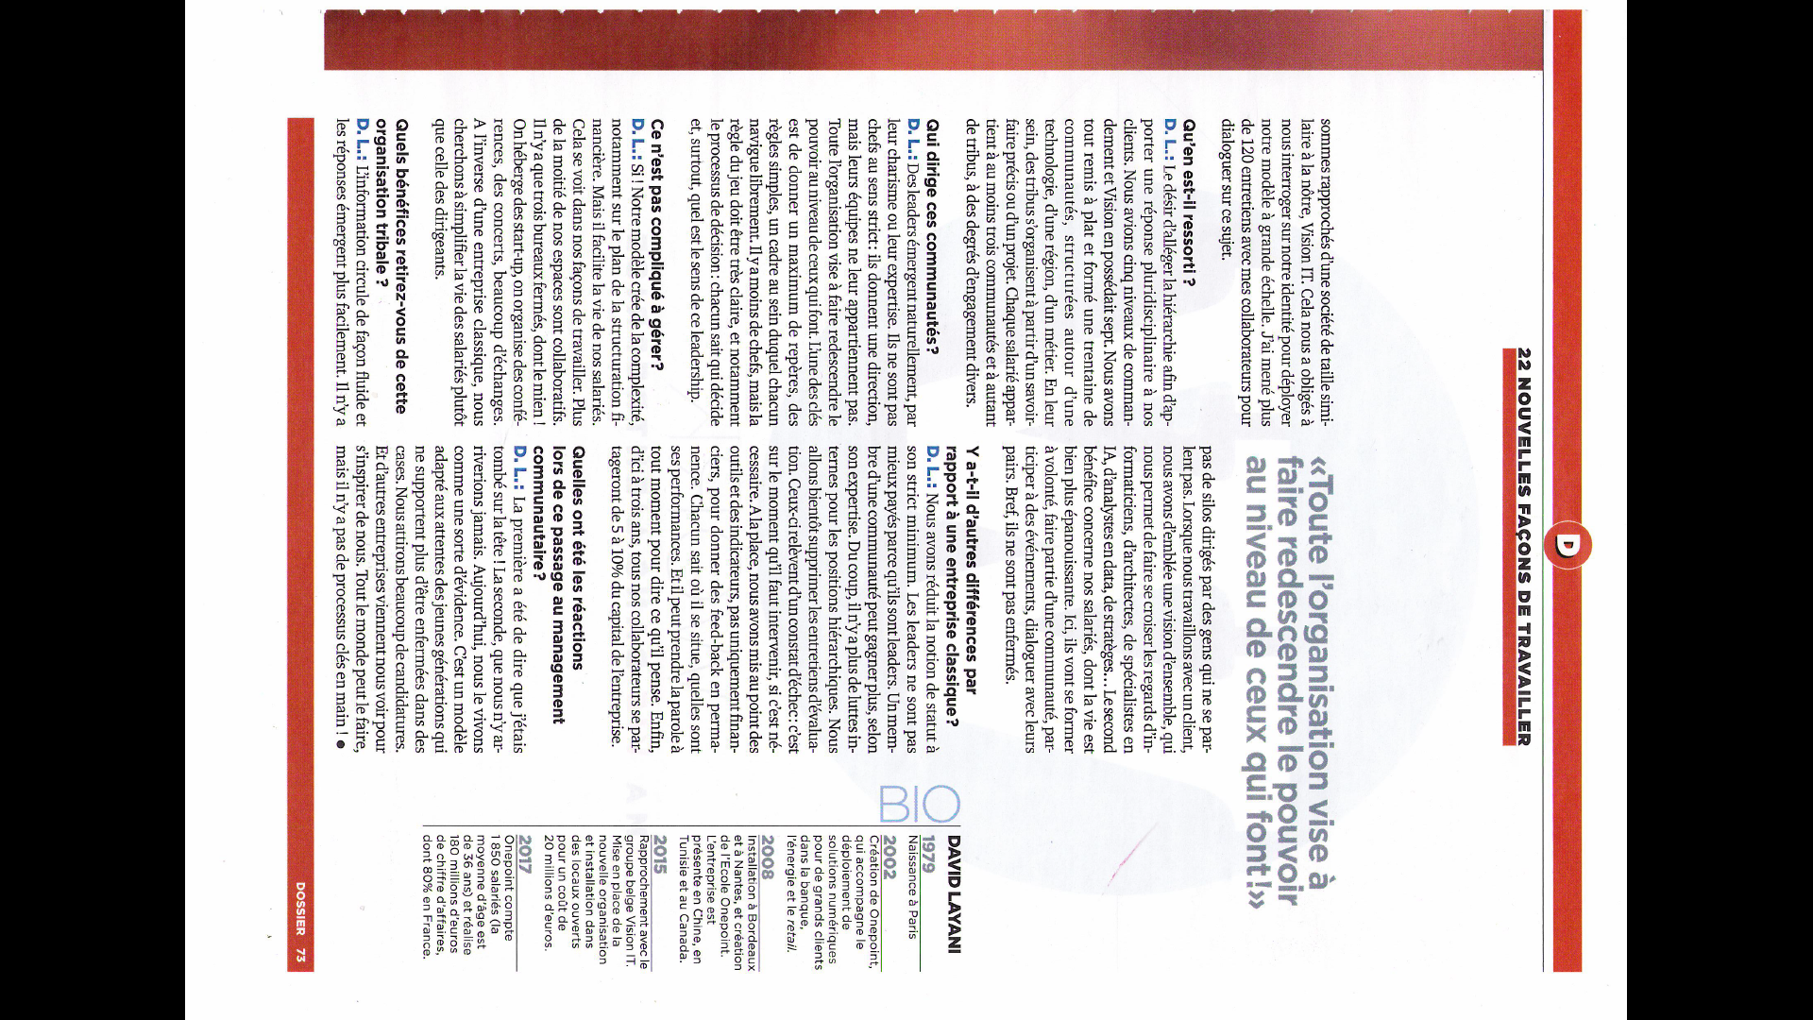
Management

Slide 19
L’Express –

Slide 20
L’Express –

Slide 21
L’Express –

Slide 22
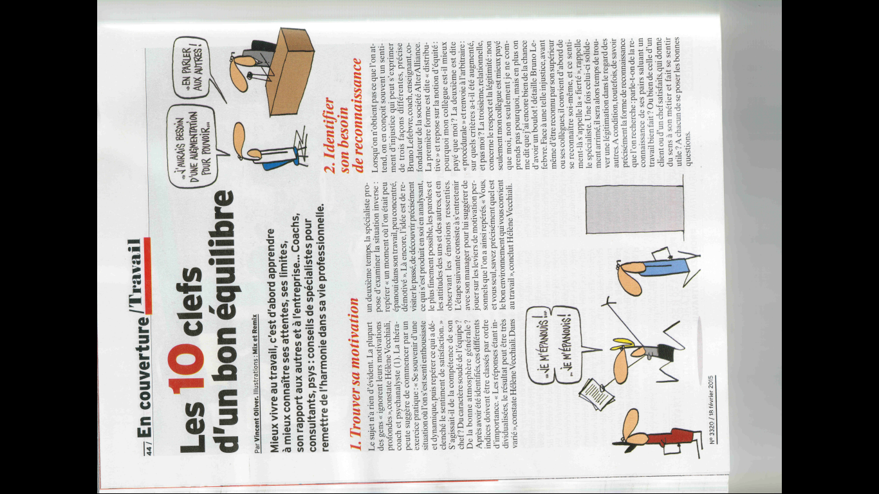
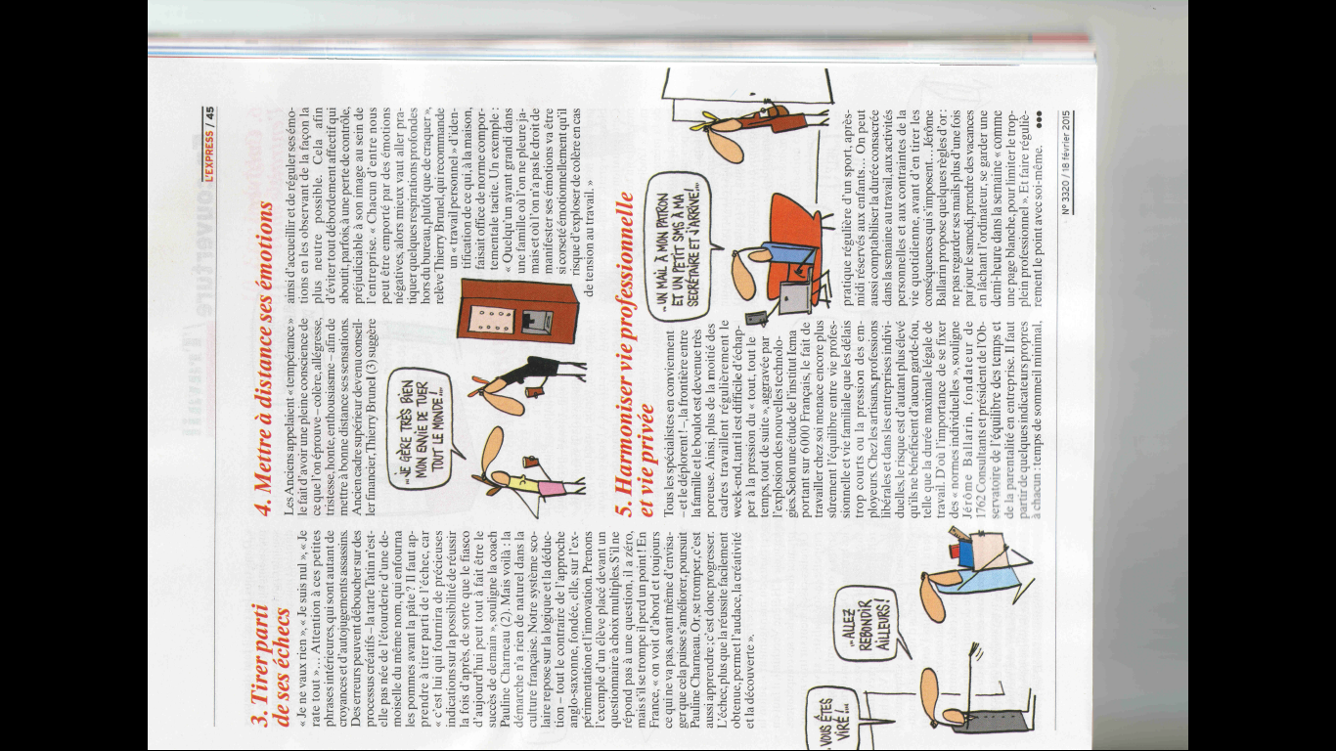
L’Express –

Slide 23
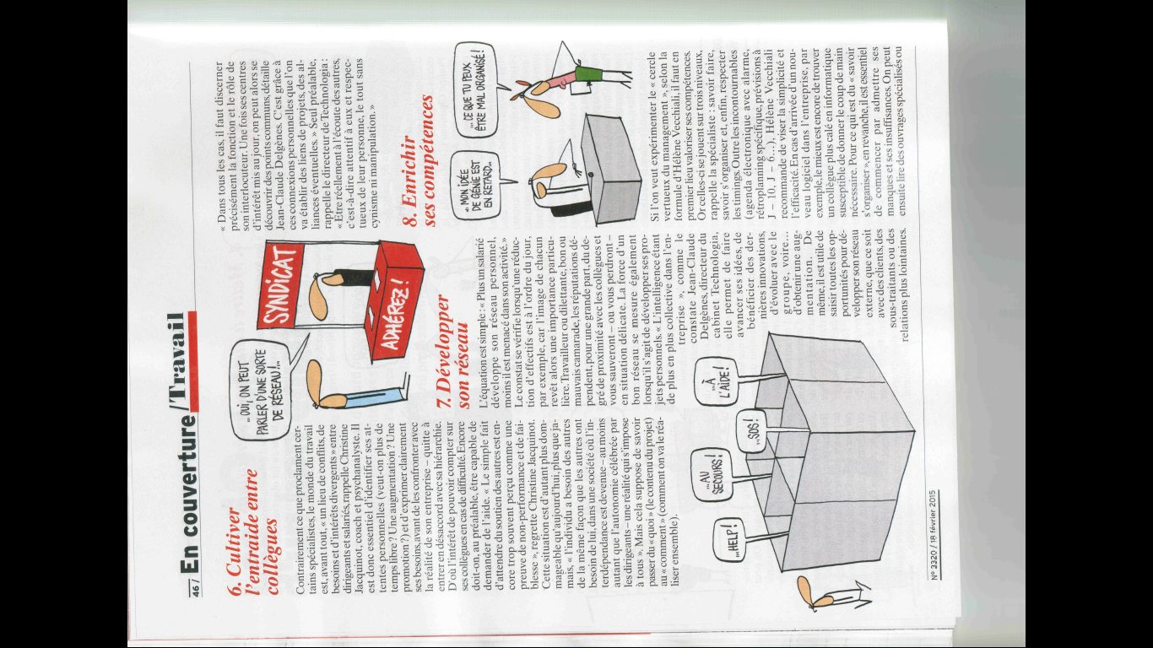
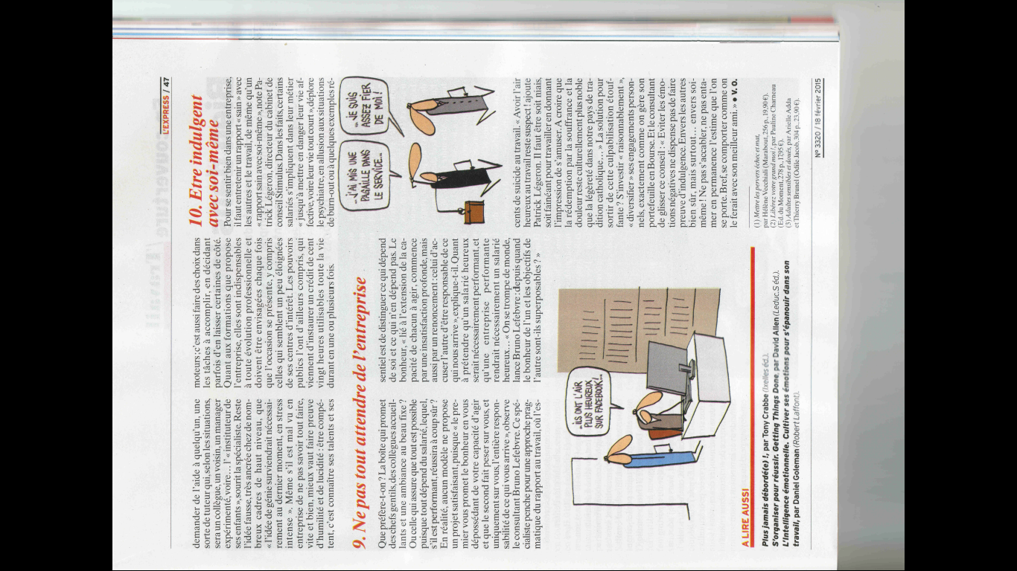
L’Express –

Slide 25
L’Entreprise –

